Slide 1

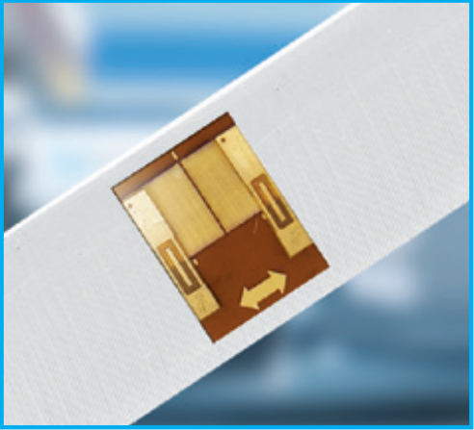
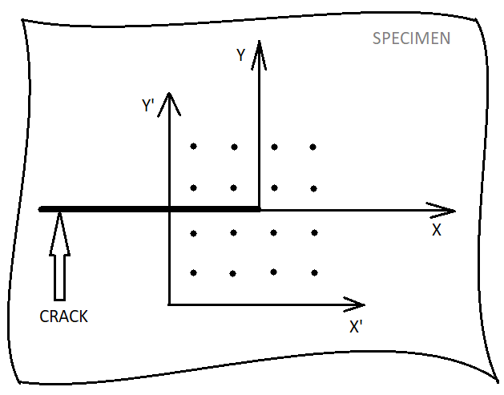
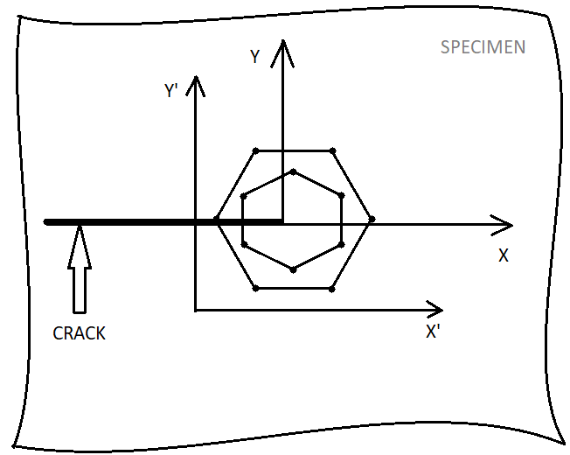
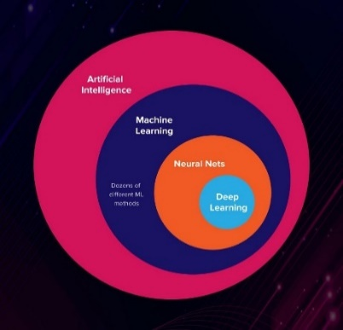
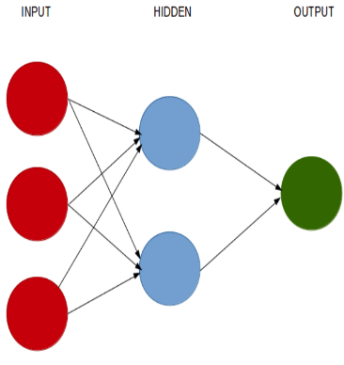
MACHINE LEARNING APPROACHES TO THE INVERSE PROBLEM OF IDENTIFYING CRACKS FROM ELECTRICAL SIGNALS IN STRUCTURAL HEALTH MONITORING
Presentation by:
Vundurthy, Padmanabha Pavan Chandra
Course: M.Sc. Computational Materials Science
1st Examiner (Supervisor) : Prof. Dipl.-Ing. Björn Kiefer, Ph.D.
2nd Examiner (Reviewer) : PD Dr.-Ing. habil. Geralf Hütter

Slide 2
Introduction
Fracture Mechanics studies cracks, prevents any damage and maintains the safety of any structure balancing the design and predicting the usability.
Fracture processes below the critical load develop in a stable manner with a very low rate of growth.
The optimum use of data from Structural Health Monitoring (SHM) is to assess the structural integrity and for damage prognosis.

Slide 3
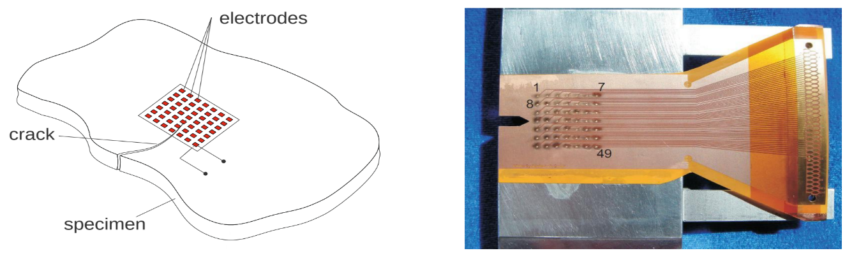
Motivation
Figure : Sensor array for SHM of cracks [1]
Cracks emerge from manufacturing processes or nucleate due to fatigue of material.
Manual monitoring of cracks is expensive.
Automated SHM solutions are an efficient alternative, e. g. strain gauges.
However, alternatives require solution of inverse problem.
Implementation of a sensor concept using Neural Networks to solve inverse problem.

Slide 4
Subtasks for the thesis
Theoretical construction of the strain fields for arbitrarily located cracks and loadings.
Computation of respective virtual electrical signals of nano strain gauges as training data for NN.
Optimization of the structure of the NN and the sampling of the training data.
Comparison of different layouts of sensor arrays.

Slide 5
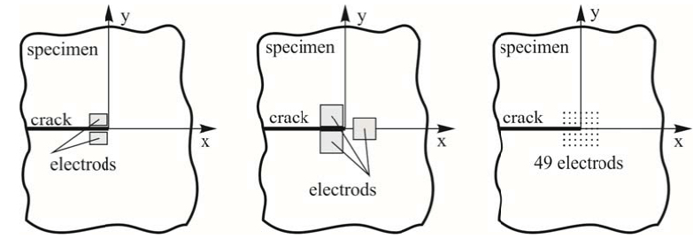
Sensor concept using PVDF film
2 electrodes
3 electrodes
49 electrodes on a film
Figure: Position of piezoelectric elements from [7] and [8] with 2 and 3 electrodes and with 49 electrodes [4].
A method for measuring SIF’s using a piezoelectric material.
The induced electrical signals due to strains are a measure of crack load situation
The crack position must be known for 2 and 3 electrode arrangement
It allows the simultaneous determination of the crack tip location and the k-factors by solving inverse problem from solution of near crack tip fields.

Slide 6
Introduction to AI and ML
Artificial Intelligence (AI) is referred as an umbrella term to describe problems from simple analytics to advanced learning algorithms.
AI leverages computers and machines to mimic the problem-solving and decision-making capabilities of the human mind.
AI is generally divided into 3 categories:
Weak AI (Narrow Capability)
Strong AI (General Capability)
Super AI (Transcendent Capability)
Machine Learning (ML) provides ability to learn automatically from data and improve from experience without explicit programming.
Current focus of data scientists in AI :
Machine Reasoning
Robotics

Slide 7


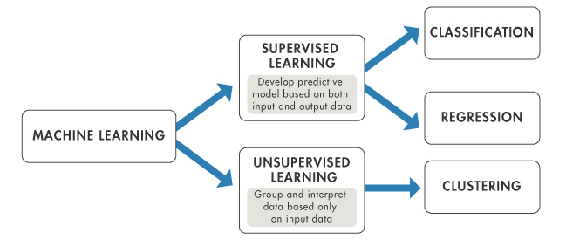

Overview of Machine Learning
Types of Machine Learning
Supervised learning
Unsupervised learning
Semi-supervised learning
Reinforcement learning
Figure: Supervised Learning
Figure: Unsupervised Learning
Figure: Reinforcement Learning
Figure: Supervised vs. Unsupervised Learning

Slide 8
Deep Learning
Deep learning (DL) is a subset of ML
Uses Neural Networks (a structure similar to a human neuron) to perform analysis.
It can ingest unstructured data in its raw form (text, images etc.)
It can determine hierarchy of features which can distinguish different categories of data from one another.
Tasks implemented using Neural Networks:
Classification
Classification with missing inputs
Predictive (Regression) analysis
Clustering
Feature engineering, a technique specifically used in ML by researchers.
Neural networks completes the task without the need for feature specifics.

Slide 9
Neural Networks
NN interprets sensory data through a kind of machine perception, labelling or clustering raw input.
The patterns they recognize are numerical, contained in vectors into which all real world data must be translated.
It is “universal approximator”, finds correlation of inputs (x) to outputs (y) using a suitable function f .
Classification
Binary classification
Multiclass classification
Multilabel classification
Regression
Linear regression
Logistic regression

Slide 10
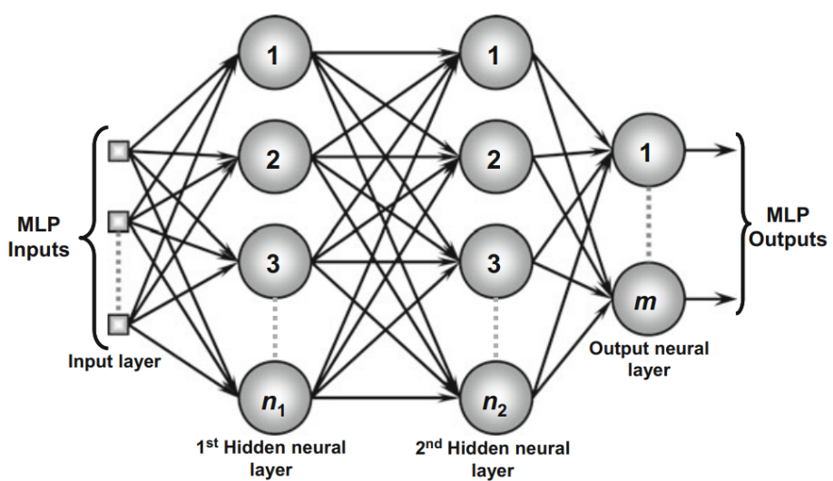
Architecture of Neural Network
Perceptron is a mathematical model of biological neuron mimicking their perception of signals from each other.
It is a feed forward neural architecture.
Initially, parameters (weights and bias) are pondered on each input to quantify and map the input/output behavior.
Two types of perceptron networks exist, namely, Single layer and Multilayer perceptron networks (MLP)
MLP has at least one intermediate (hidden) neural layer between input and output neural layer.
Figure: Illustration of MLP [5]
Input layer
Hidden layers
Output layer

Slide 11
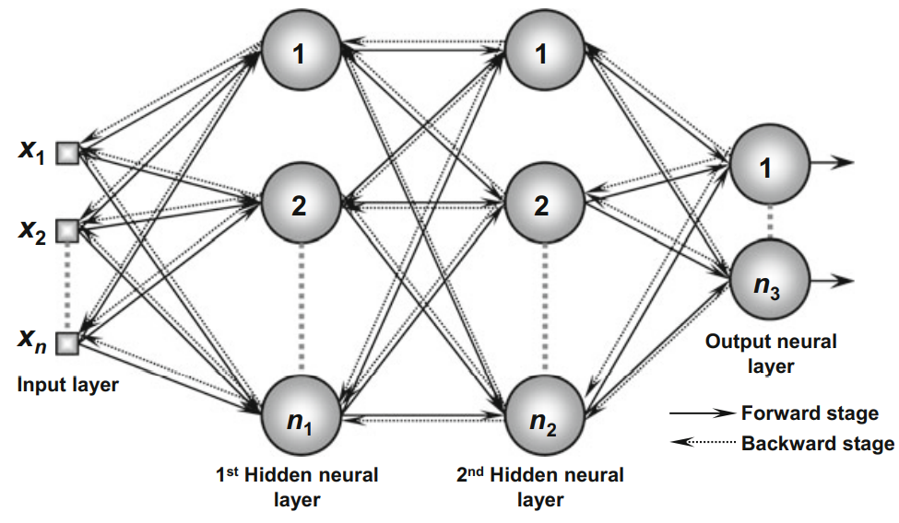
Working principle of MLP
Inputs are propagated layer by layer towards output.
Adjustments of weights of each neuron is guided by a supervised training process:
Forward propagation
Backward propagation
Update (rule) for gradient descent.
Underlying optimization problem is guided by loss function.
Slight change in weights causes slight change in error.
Activation function bounds the input values and propagates accordingly.
Figure: Training of MLP [5]
Essence of Deep Learning : Adjust a model’s weights in response to the error, until the error cannot be reduced (reasonably) any further.

Slide 12
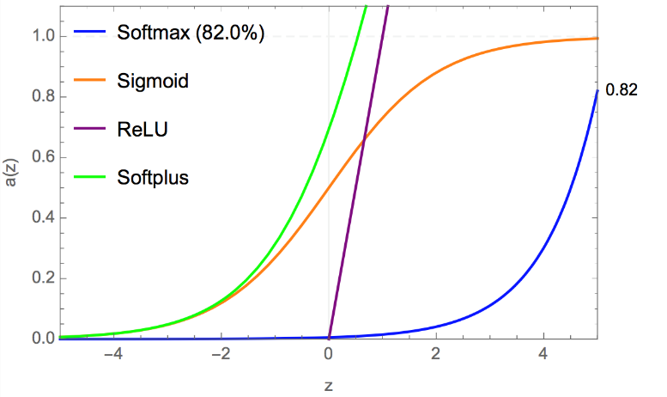
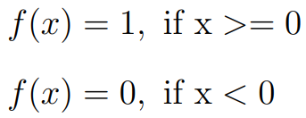
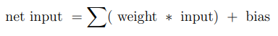
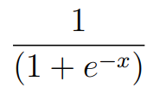
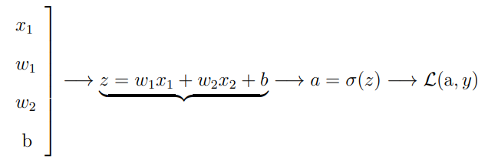
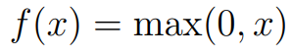
Activation function
The value of net input can be anything from –inf to +inf.
It bounds the value of the net input.
It is a non- linear transformation of the input value before propagating to the next layer of neurons or finalizing it as output.
Types of activation function:
Step function:
Sigmoid function
ReLU
Figure: Activation function
Z

Slide 13
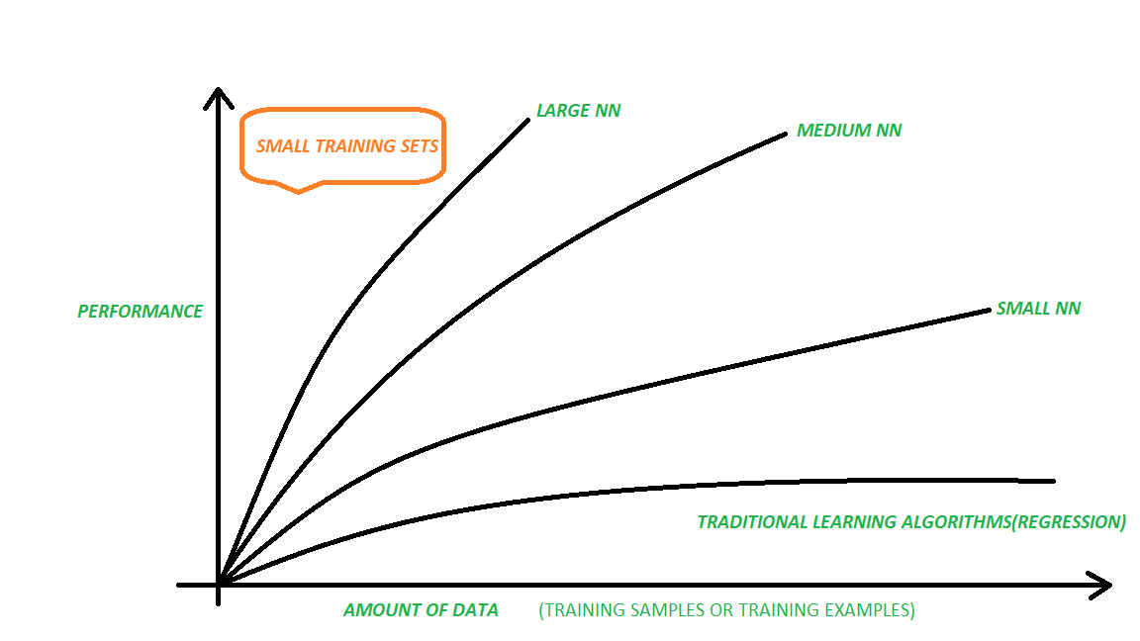
Dataset
Three kinds of datasets play a crucial role in building an efficient NN:
Training dataset
Validation dataset
Testing dataset
Training dataset: used to fit a model using supervised learning methods.
Validation dataset: it is a percentage of the training dataset used for computing validation loss.
Testing dataset: it contains input data which should have same signature as the training dataset.

Slide 14
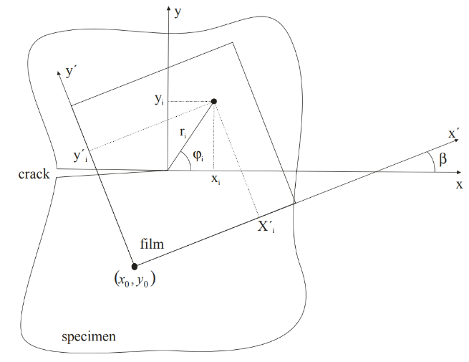
Sensor concept: crack and sensor arrangement
The method for measuring SIF’s using a piezoelectric material: sensor concept (arrangement of electrodes) is presented by D. Bäcker and M. Kuna [2].
The practical application of sensor concept is focused on the detection of unknown crack positions and SIF’s.
This indicates that:
The crack position is unknown w.r.t the sensor arrangement.
Coordinates of measuring points (ri, φi) and c.c.s (x,y) are not available
Relation between c.c.s and l.c.s is presented by [2] as observed in the figure.
Using nano sensors to measure strain data, in this thesis, there is no need for a film like in PVDF arrangement.
Crack coordinate system (c.c.s) - (x,y)
Local coordinate system (l.c.s) – (x’,y’)
Unknowns – (x0, y0, β)

Slide 15
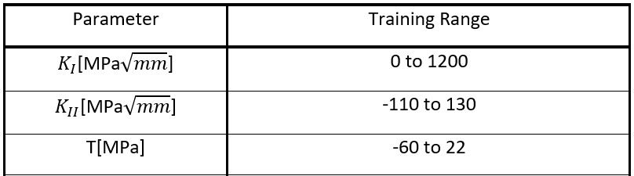
Generation of virtual training data
The sensor concept is tested in [4]
Using the equations presented there, the relation between strain data (ε11, ε22, ε12) (input) and KI , KII , T, crack angle (β), crack location] (output) can be calculated.
To generate this data, different values of [KI , KII , T, crack angle(β), crack location] are considered and iterated over a loop.
This data will be used as training data for NN
The model works only within this range
Normalizing the input data increases learning speed of the model in finding optimal parameters for input nodes
Table: Training range for a (4x4) regular rectangular layout

Slide 16
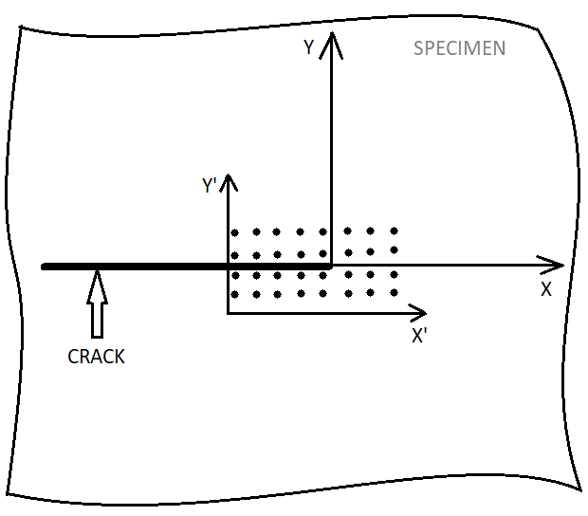
Current implementation
In this thesis, this new approach is tailored and implemented on different layouts of sensor arrays, namely:
Rectangular 4x4 Sensor arrangement
Rectangular 8x4 Sensor arrangement
Hexagonal Sensor arrangement

Slide 17
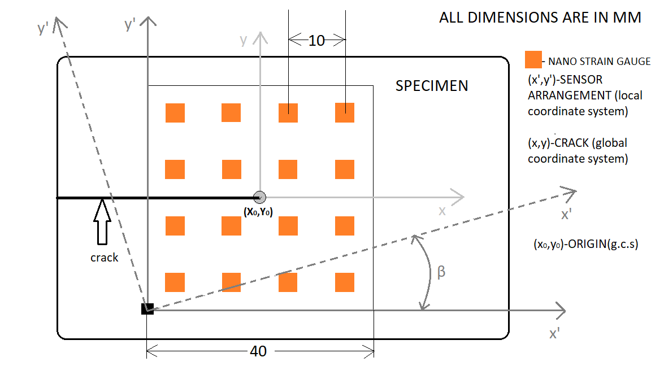
Rectangular 4x4 Sensor Arrangement
In this layout, the sensors are arranged around the crack tip in 4 rows and 4 columns equidistant to each other.
The sensor layout can rotate in an angle β.
Number of sensors (n) = 16
Input data = 48 neurons(3 strain values * n)
Output data = [KI , KII , T, cos β,sin β, Y0, X0], 7 neurons

Slide 18
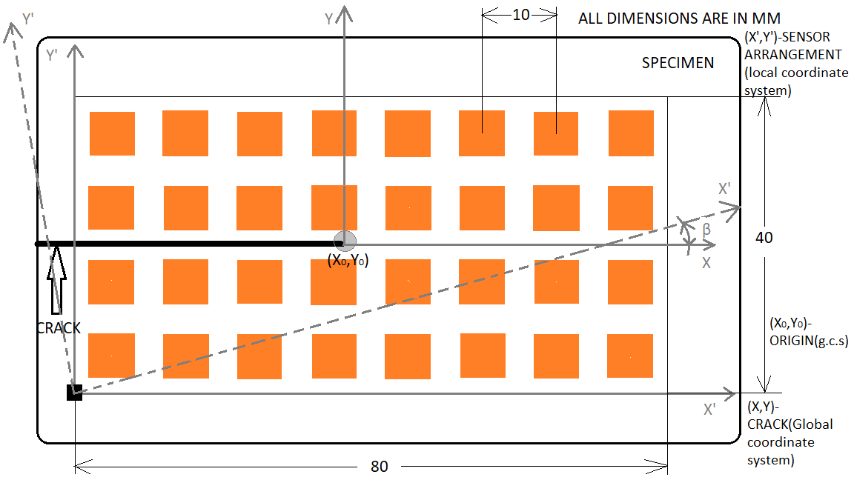
Rectangular 8x4 Sensor Arrangement
In this layout, the sensors are arranged around the crack tip in 4 rows and 8 columns equidistant to each other.
The sensor layout can rotate in an angle β.
Number of sensors (n) = 32
Input data = 96 neurons(3 strain values * n)
Output data = [KI , KII , T, cos β,sin β, Y0, X0], 7 neurons

Slide 19
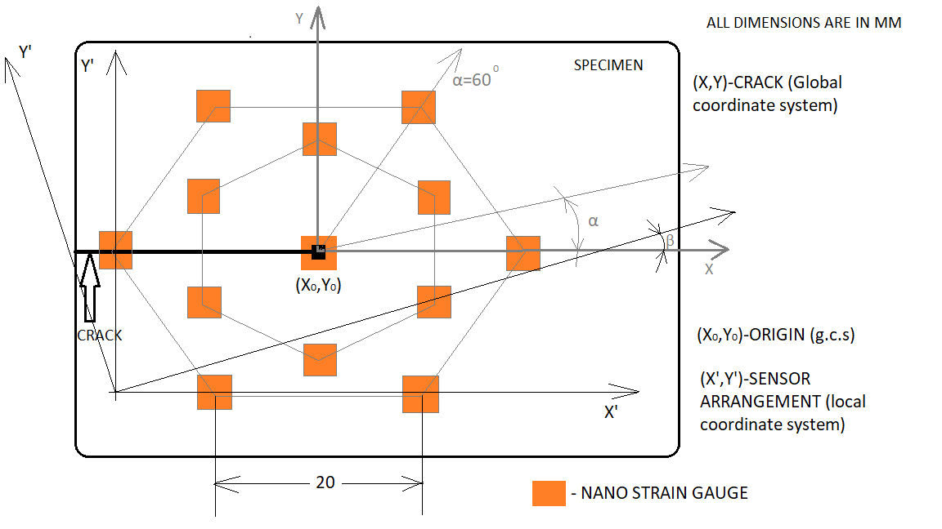
Hexagonal Sensor Arrangement
In this layout, the sensors are arranged around the crack tip like a equilateral hexagon.
Each vertex of the hexagon holds a sensor.
The centroid of each equilateral triangle of the hexagon holds another sensor.
The center of the hexagon holds another sensor.
The sensor layout can rotate in an angle β.
Number of sensors (n) = 13
Input data = 39 neurons(3 strain values * n)
Output data = [KI , KII , T, cos β,sin β, Y0, X0], 7 neurons

Slide 20
Model: Strategy and Inference
The following steps are implemented sequentially:
Fit the model using training data
Optimize the model to give better performance (hyperparameter tuning)
Compare over different layouts.
A Neural Network performance is based on its hyperparameters that control the architecture and learning of the network:
Number of Hidden Layers
Number of units for each hidden layer
Training dataset
Loss function
Learning rate
Number of epochs
Batch size
Defines the architecture of NN and performance measurement
Tuning these parameters produces an optimized model based on performance

Slide 21
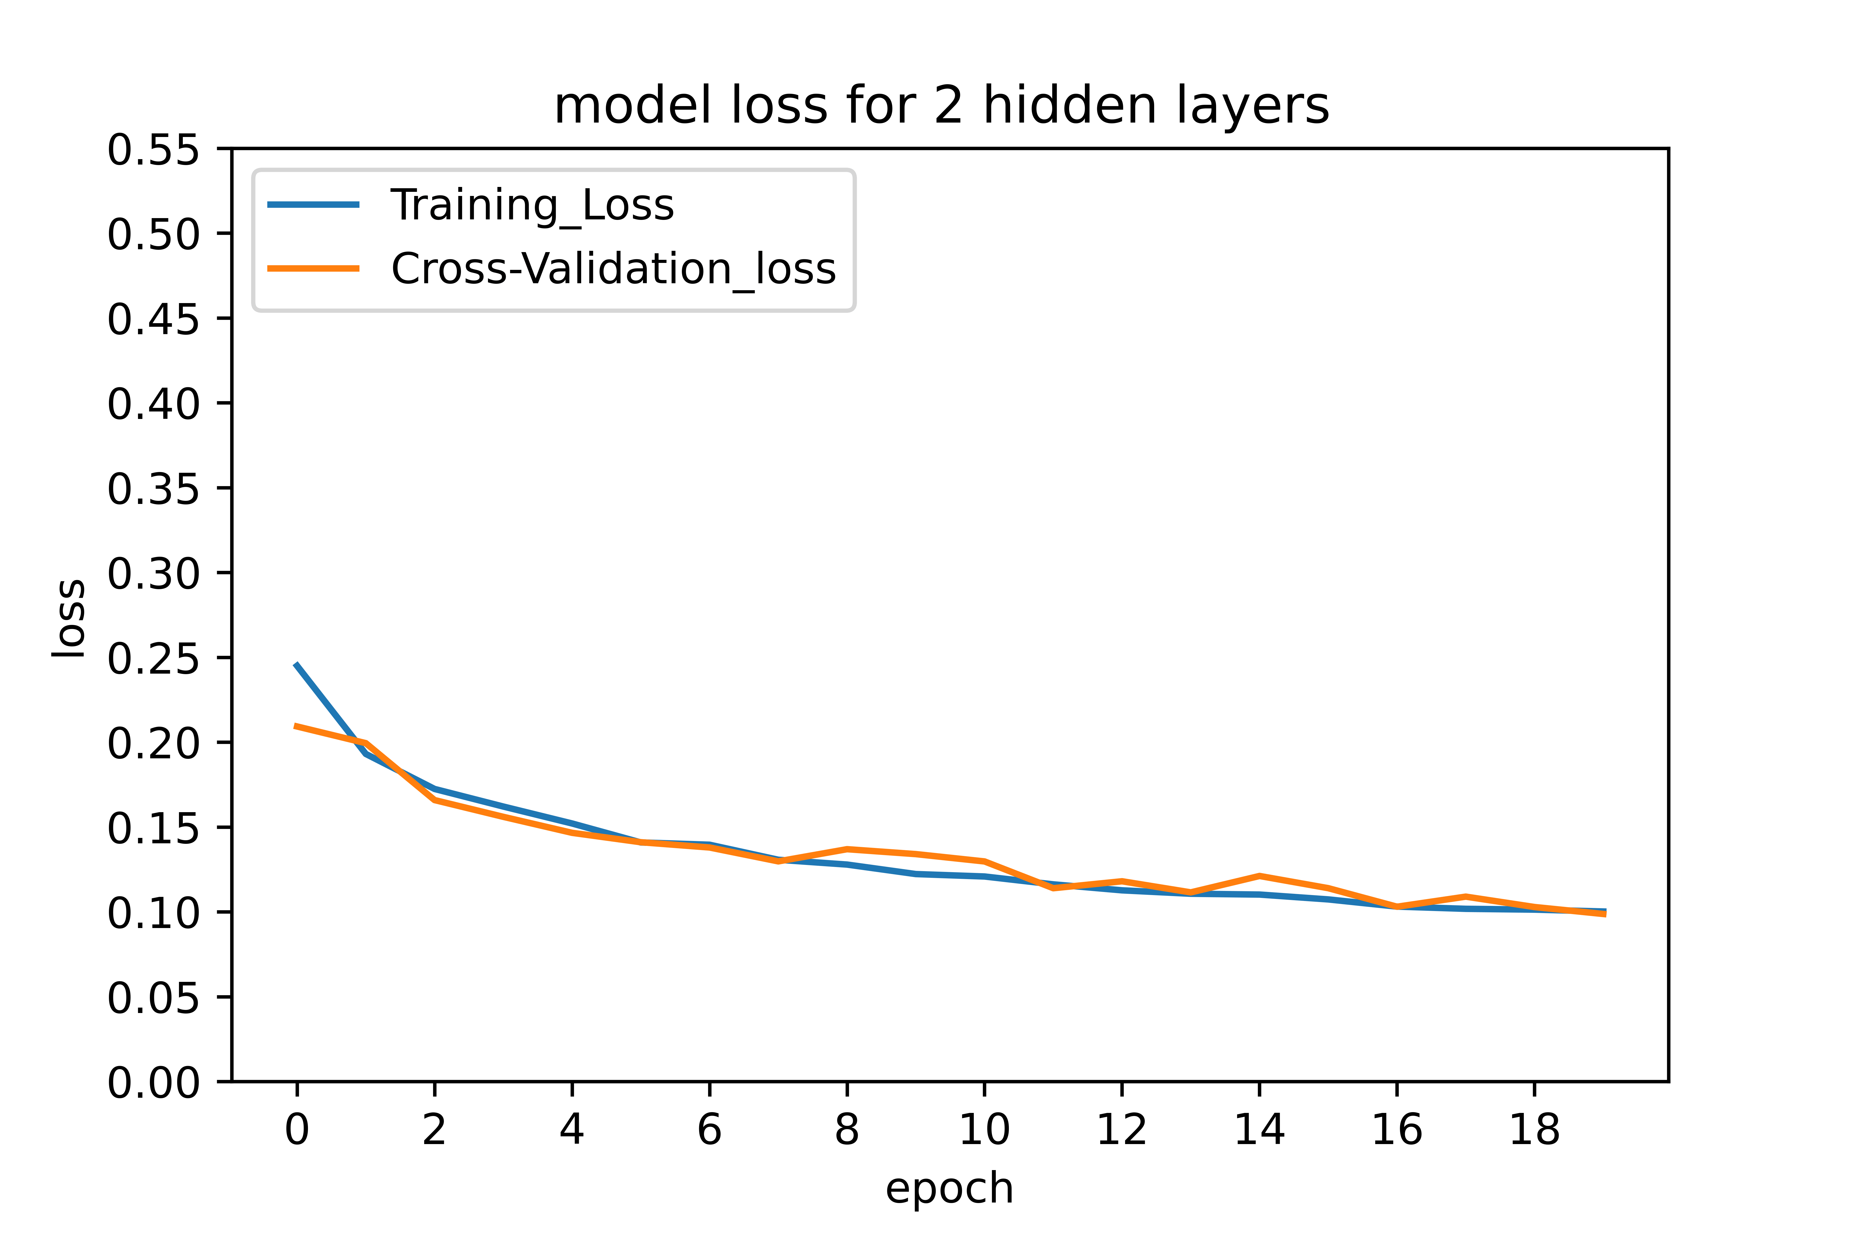
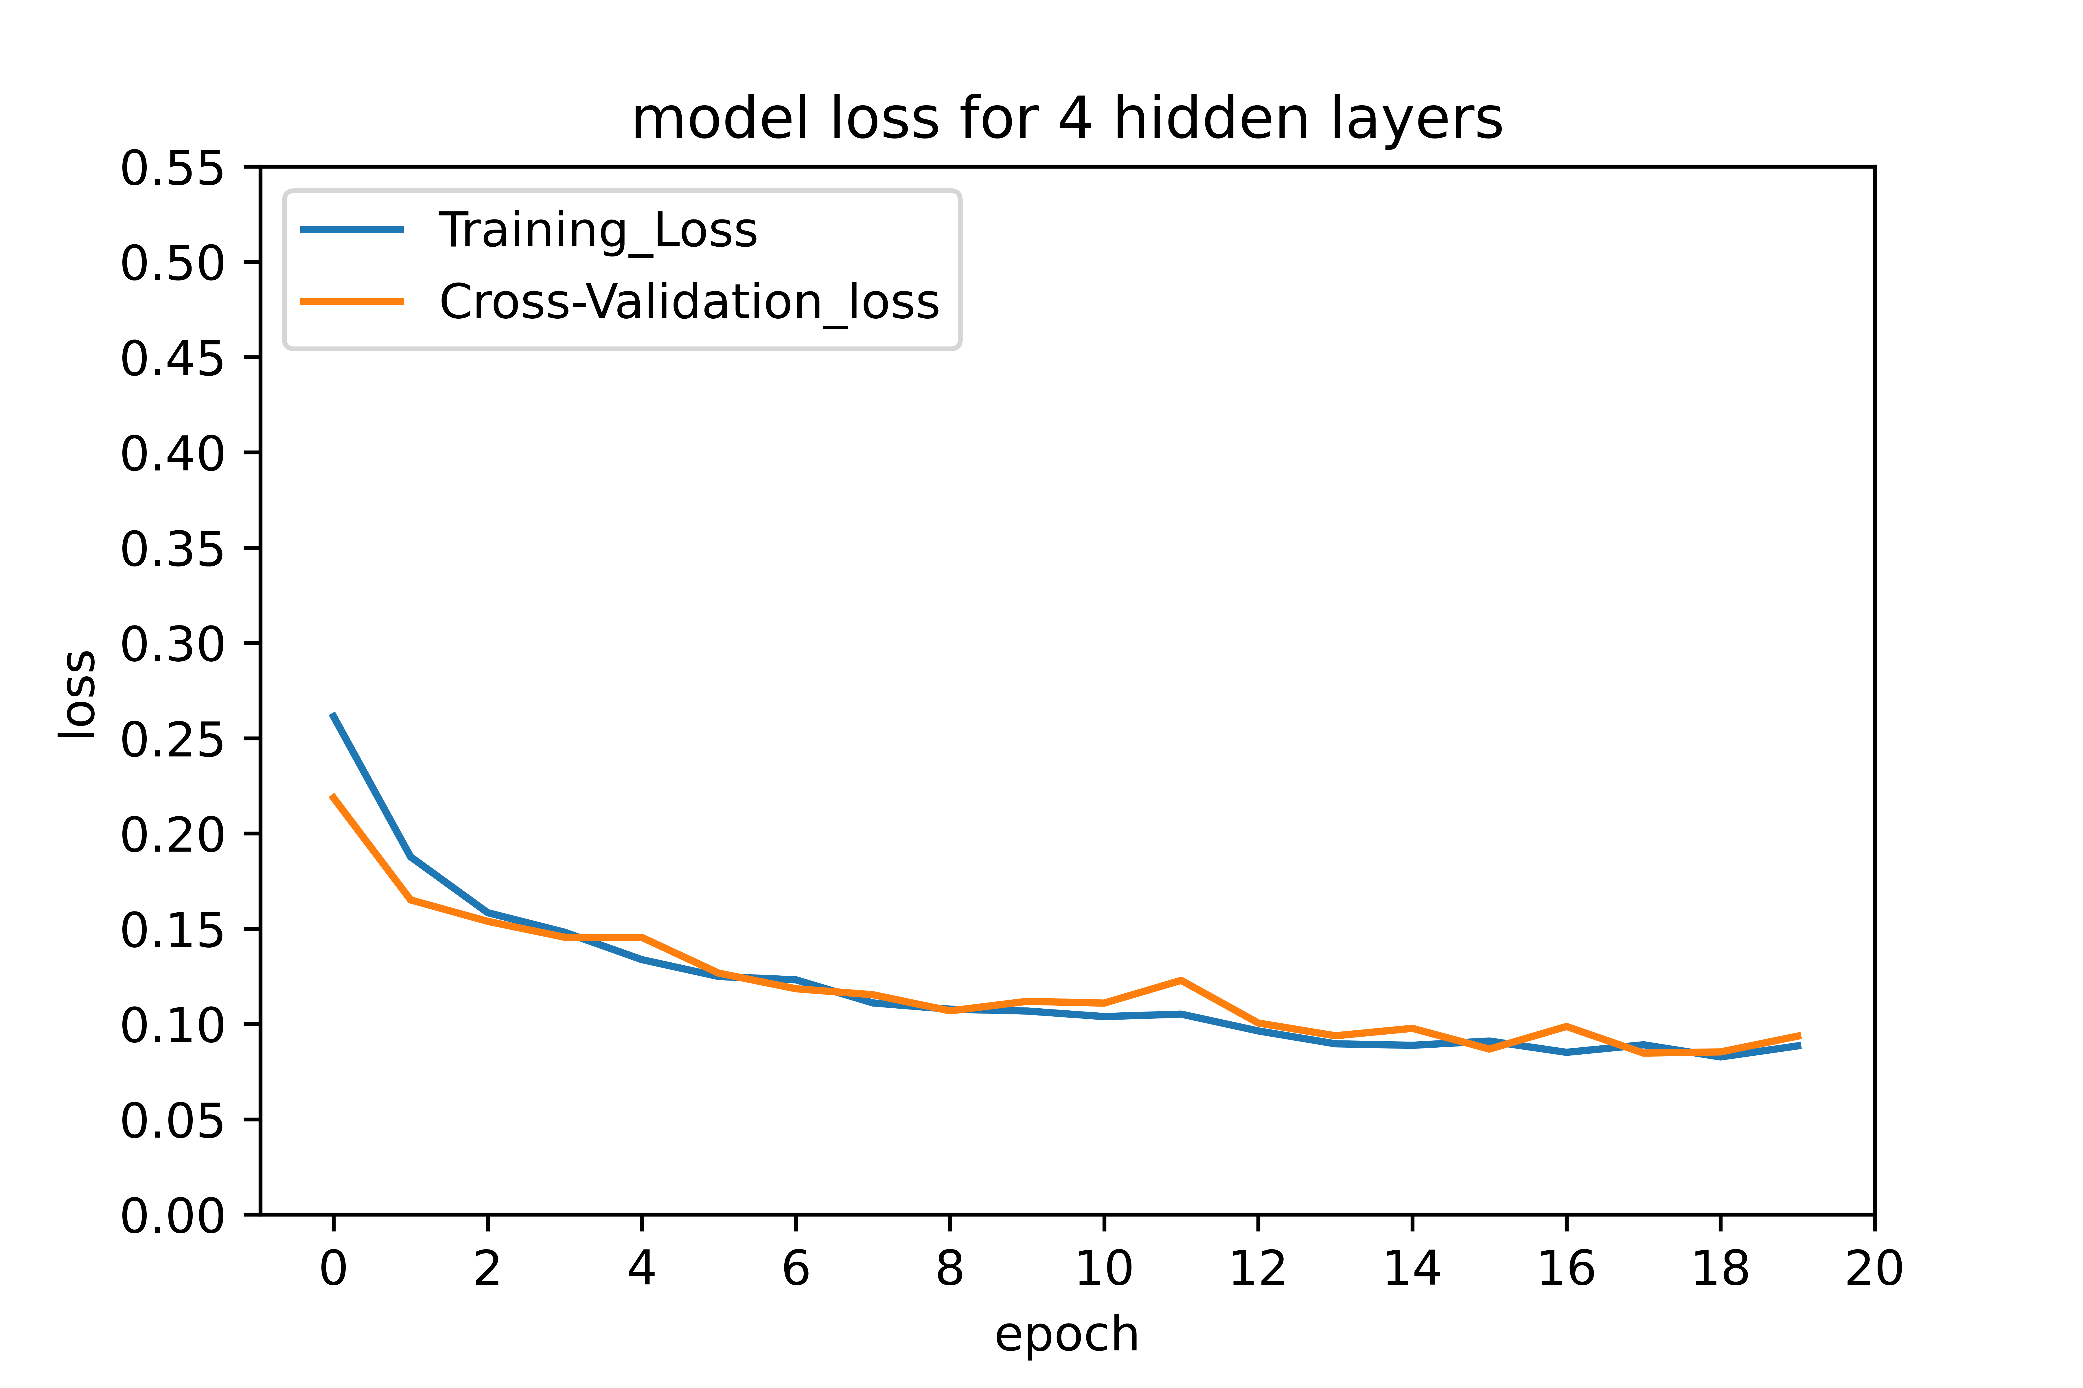
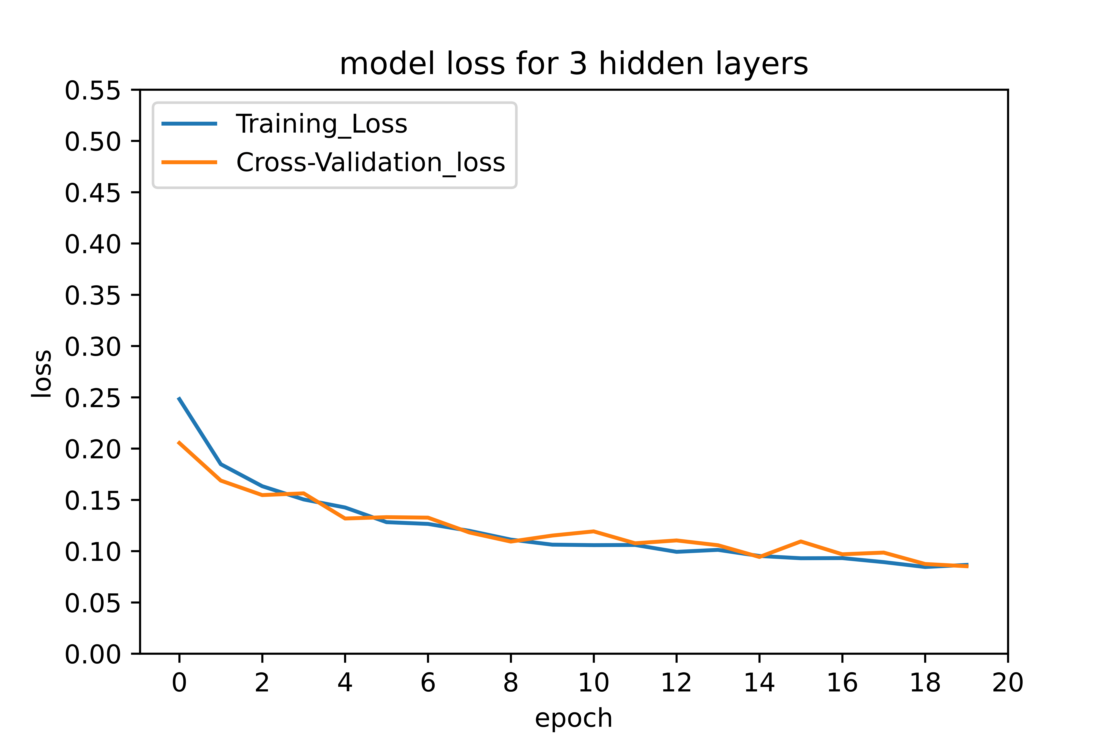
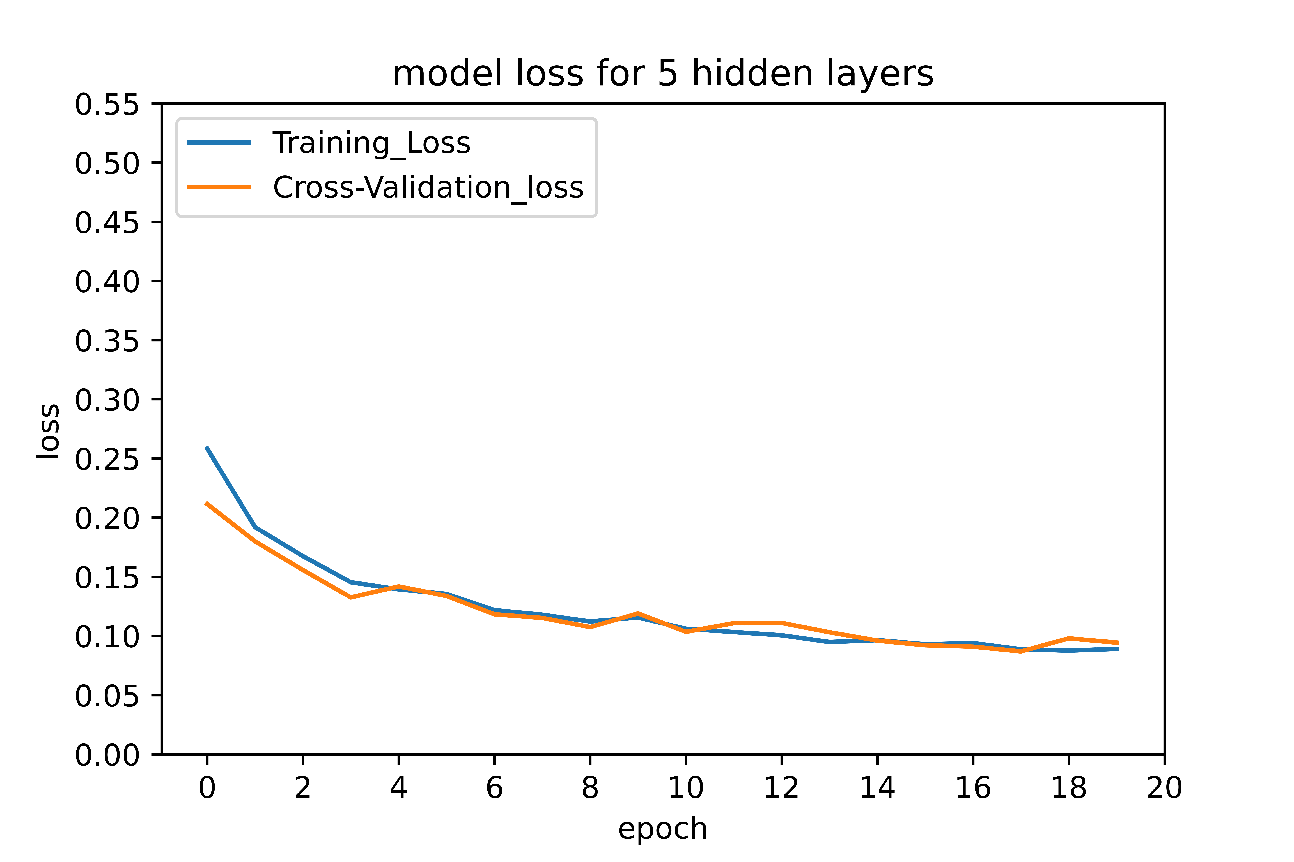
Model: Strategy and Inference
A. Choosing number of hidden layers
Inference:
Hidden layers 3,4,5 perform similarly compared to 2
More hidden layers increases computation time
Number of hidden layers = 2

Slide 22
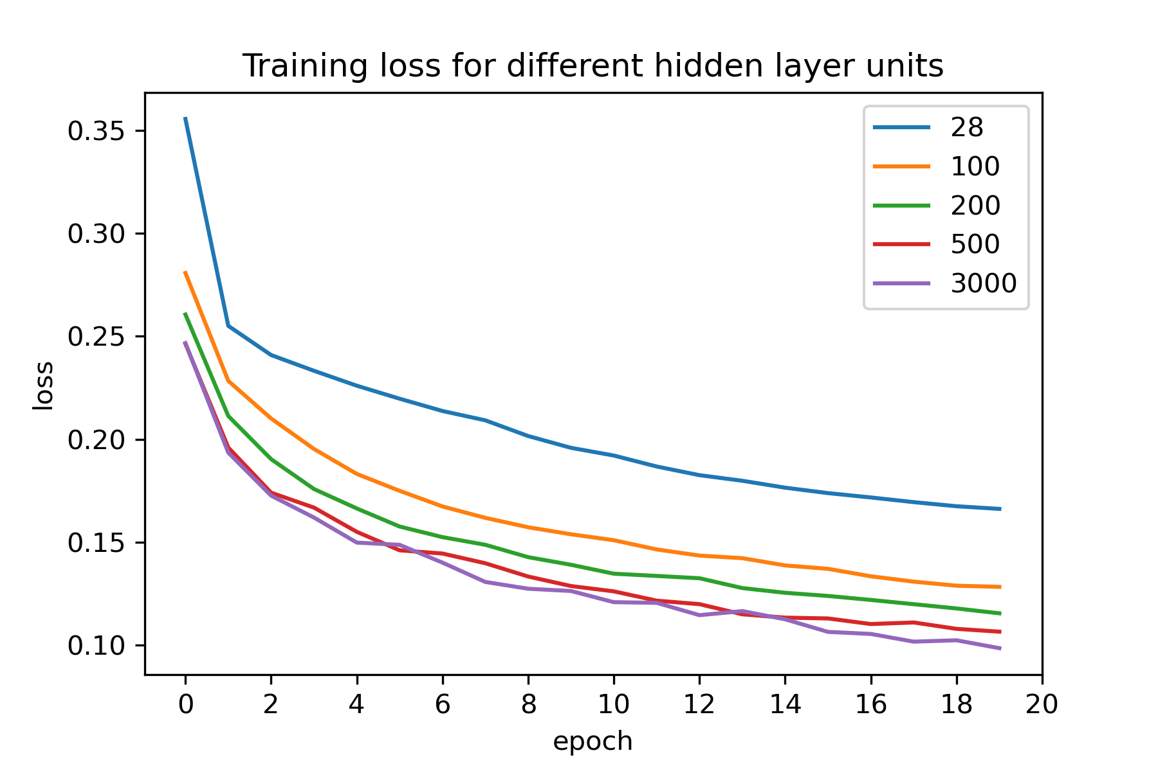
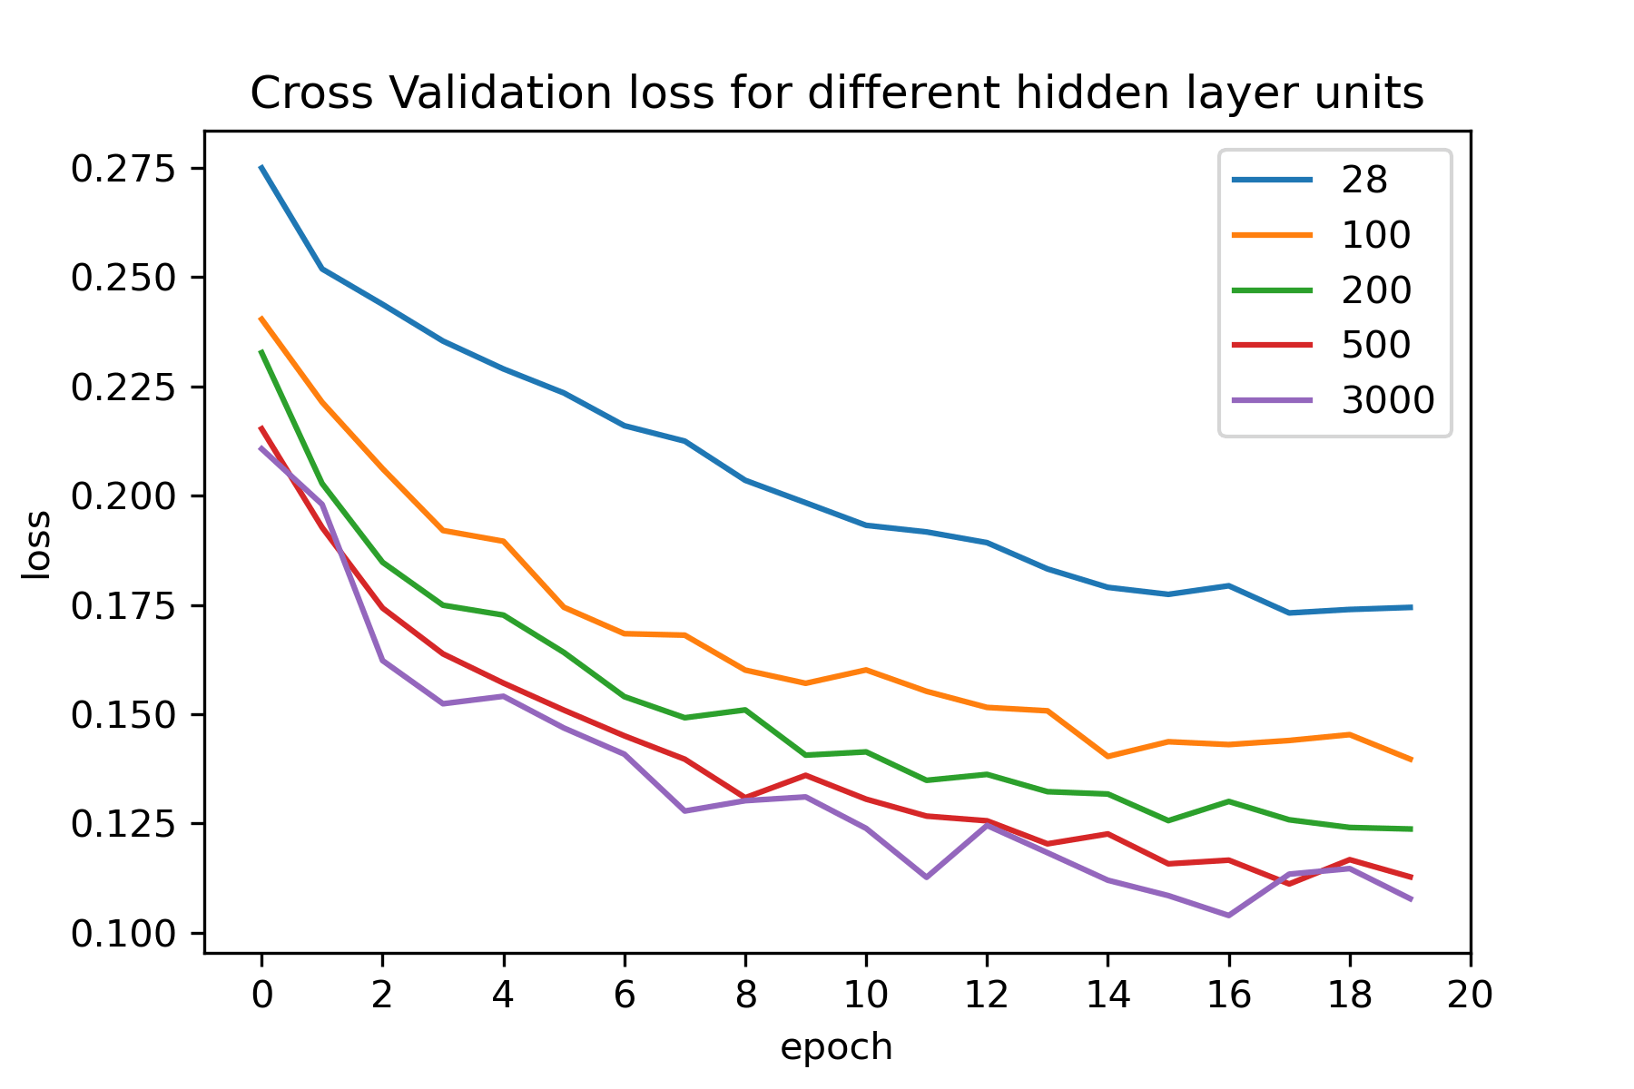
Model: Strategy and Inference
B. Choosing number of units for each hidden layer
Inference:
Empirical rules cannot be generalized over all datasets.
Each training set requires a unique architecture to extract desired performance
Systematic experimentation is performed with units ranging from 28 to 3000 for each layer
Better performance is observed between 500 to 700 units.
Number of units for each hidden layer = 700

Slide 23
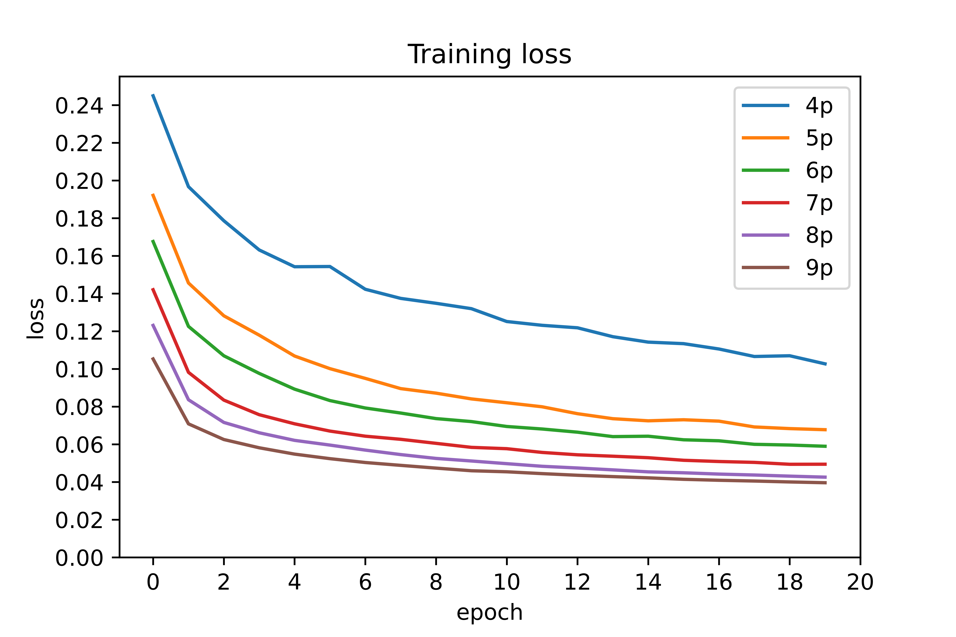
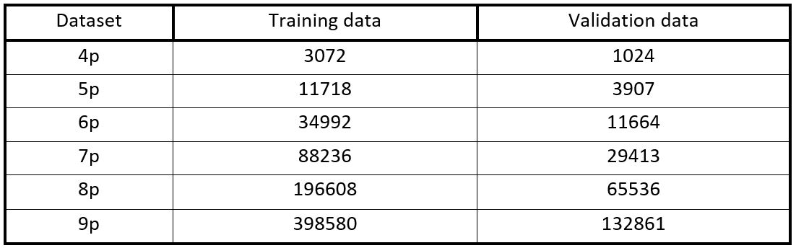
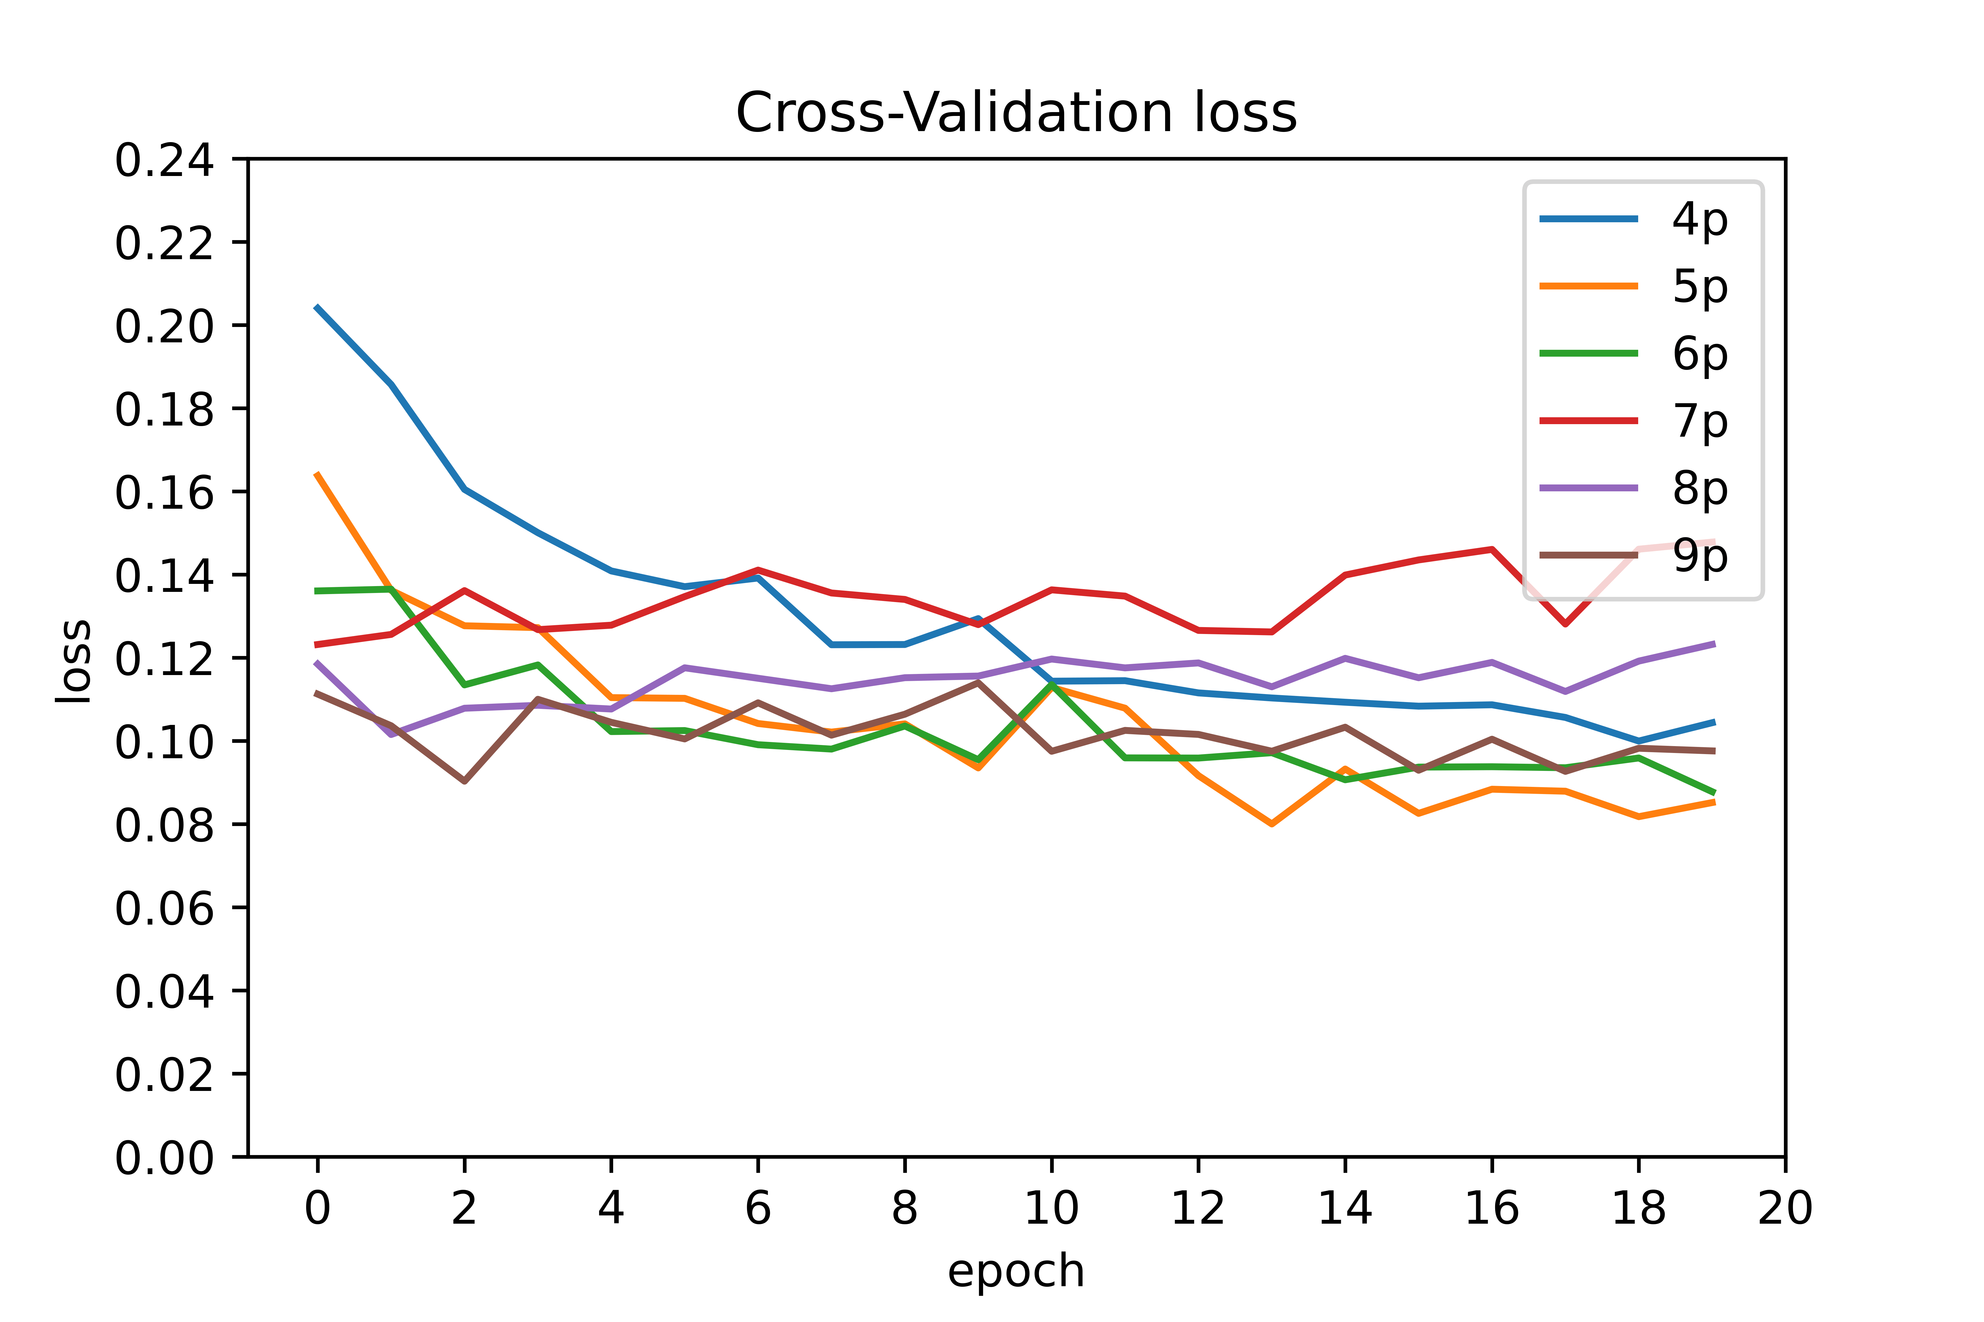
Model: Strategy and Inference
C. Choosing the training dataset
Inference:
Considering 4,5,…9 points over training range while creating dataset
Comparing which dataset is computationally efficient
Loss function = MAE, Optimizer = adam
Training dataset = 5p

Slide 24
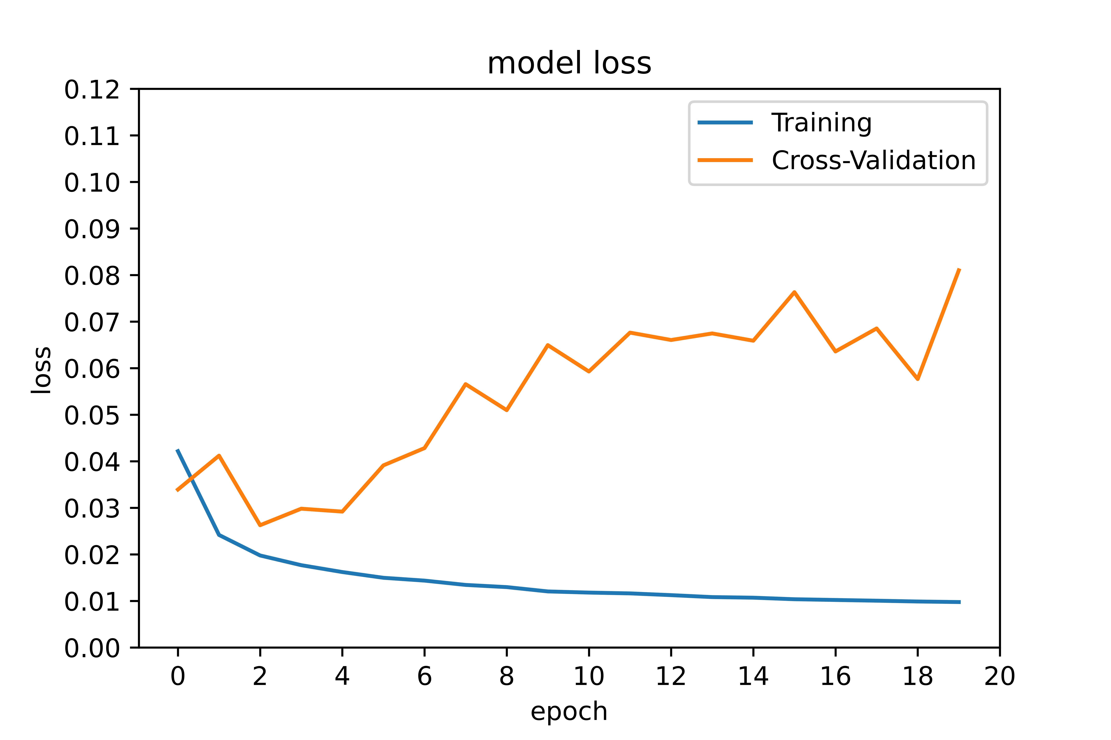
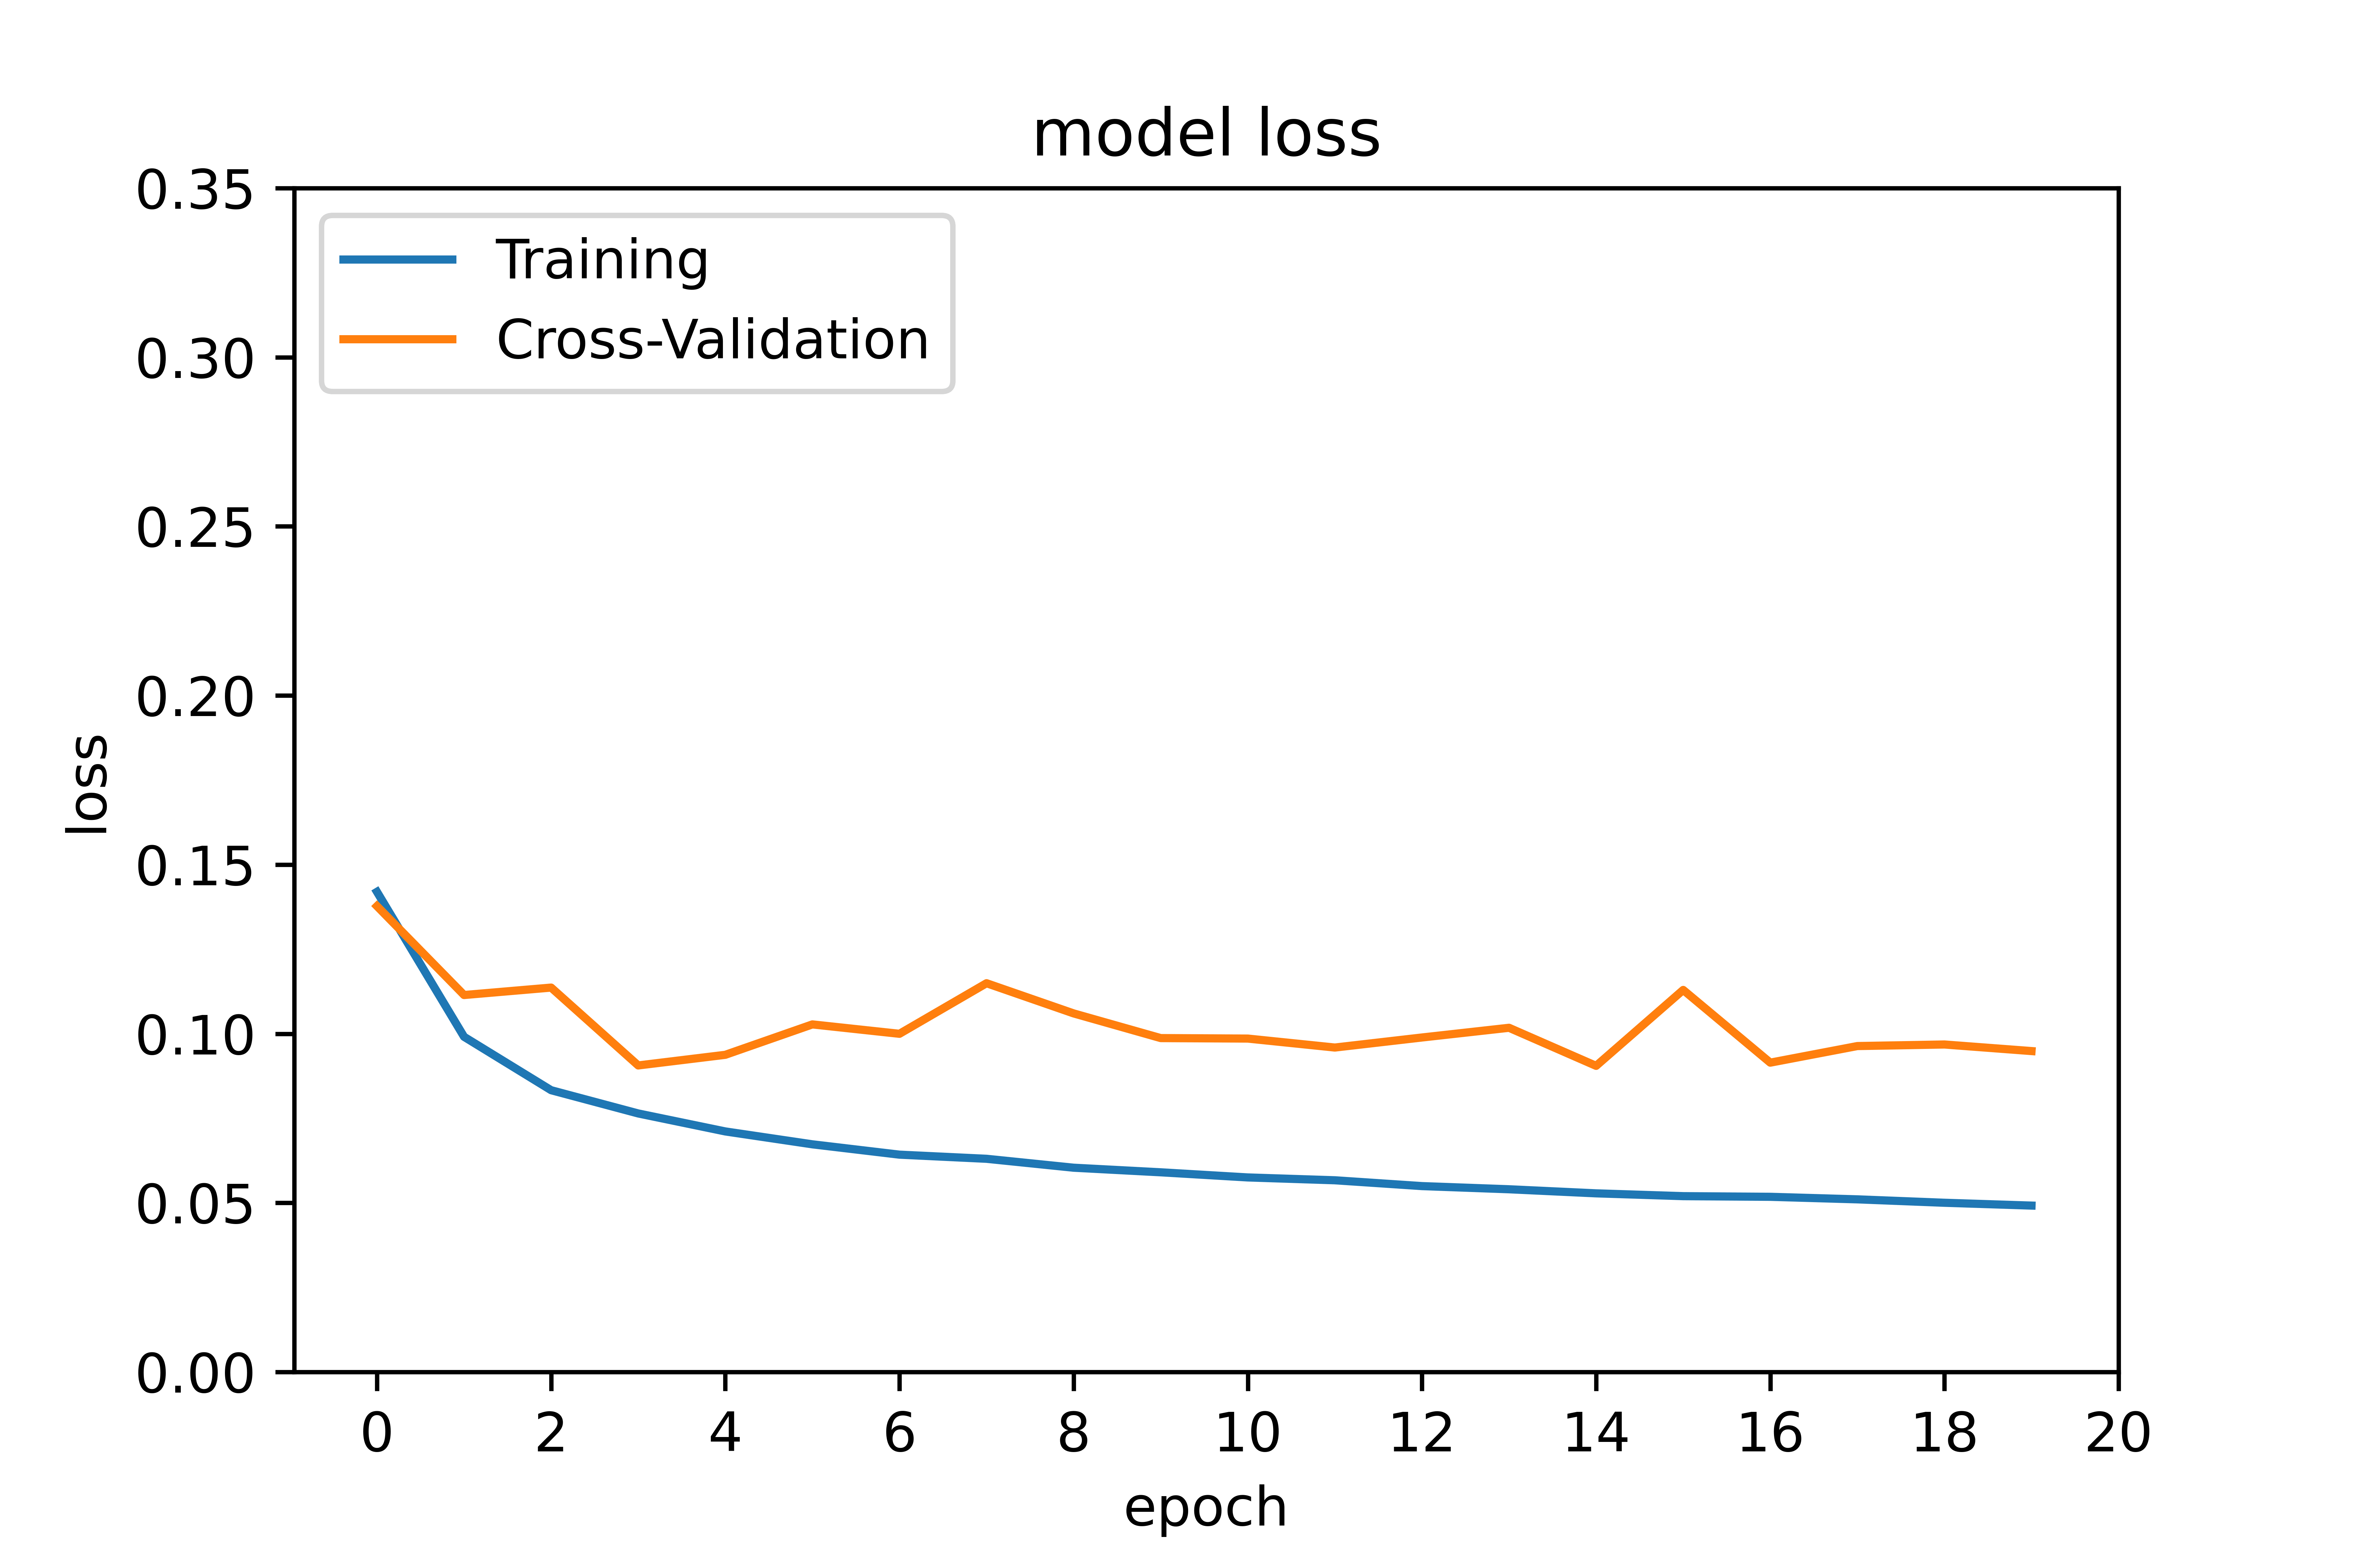
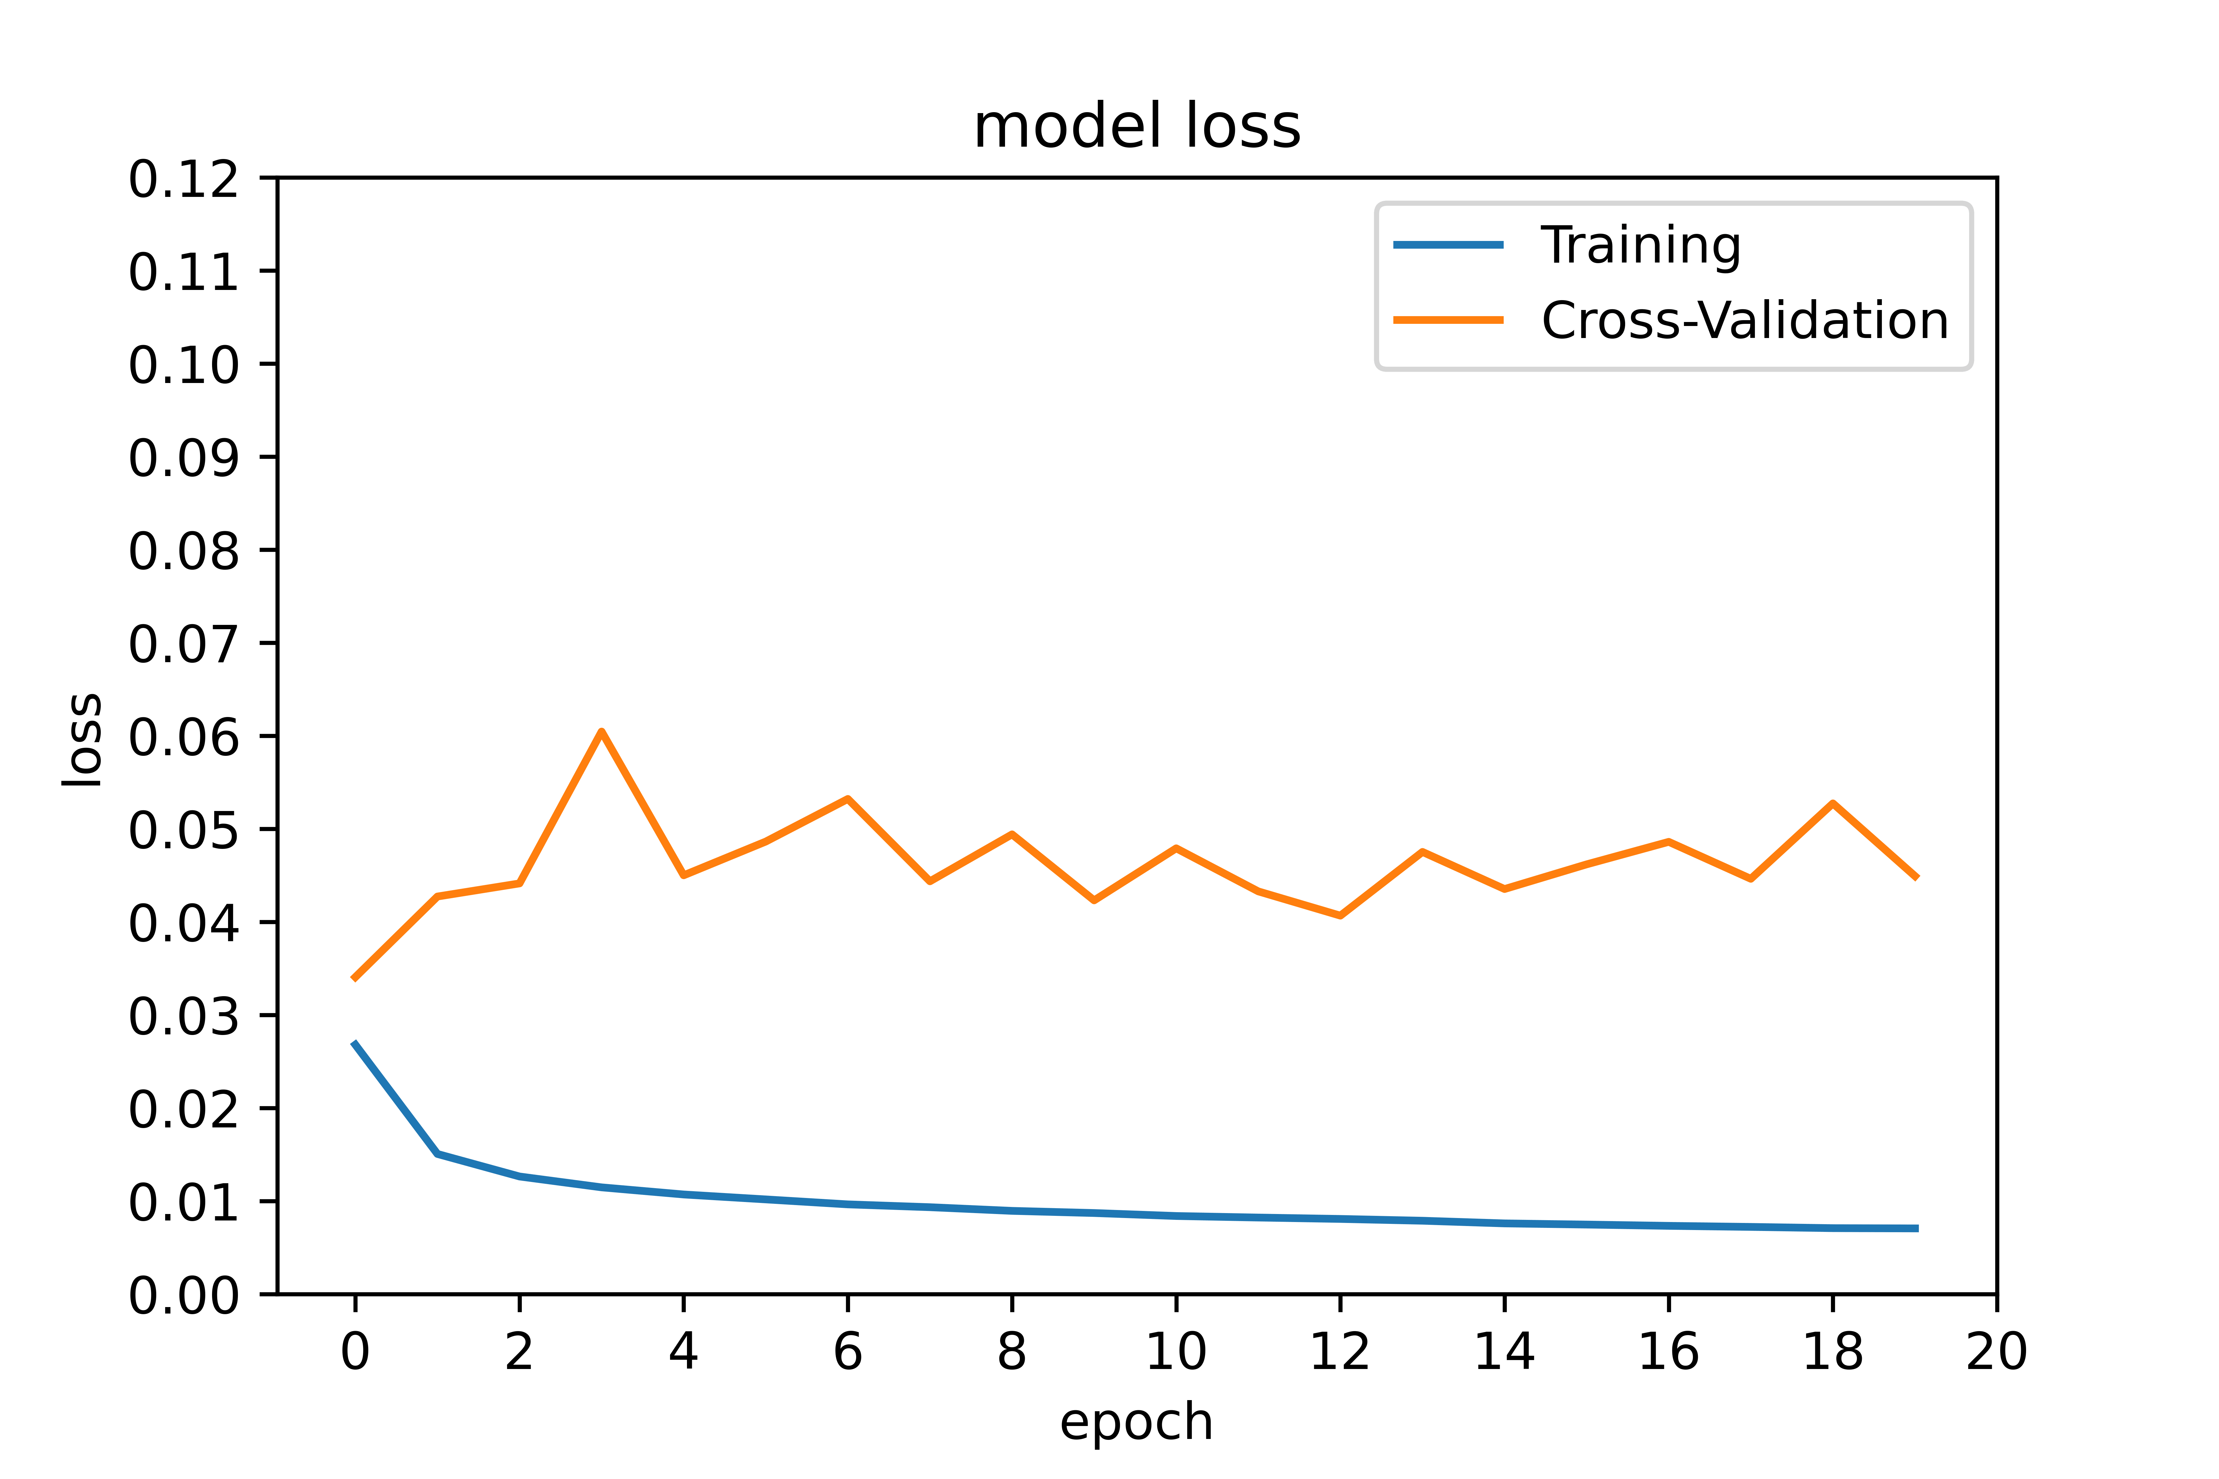
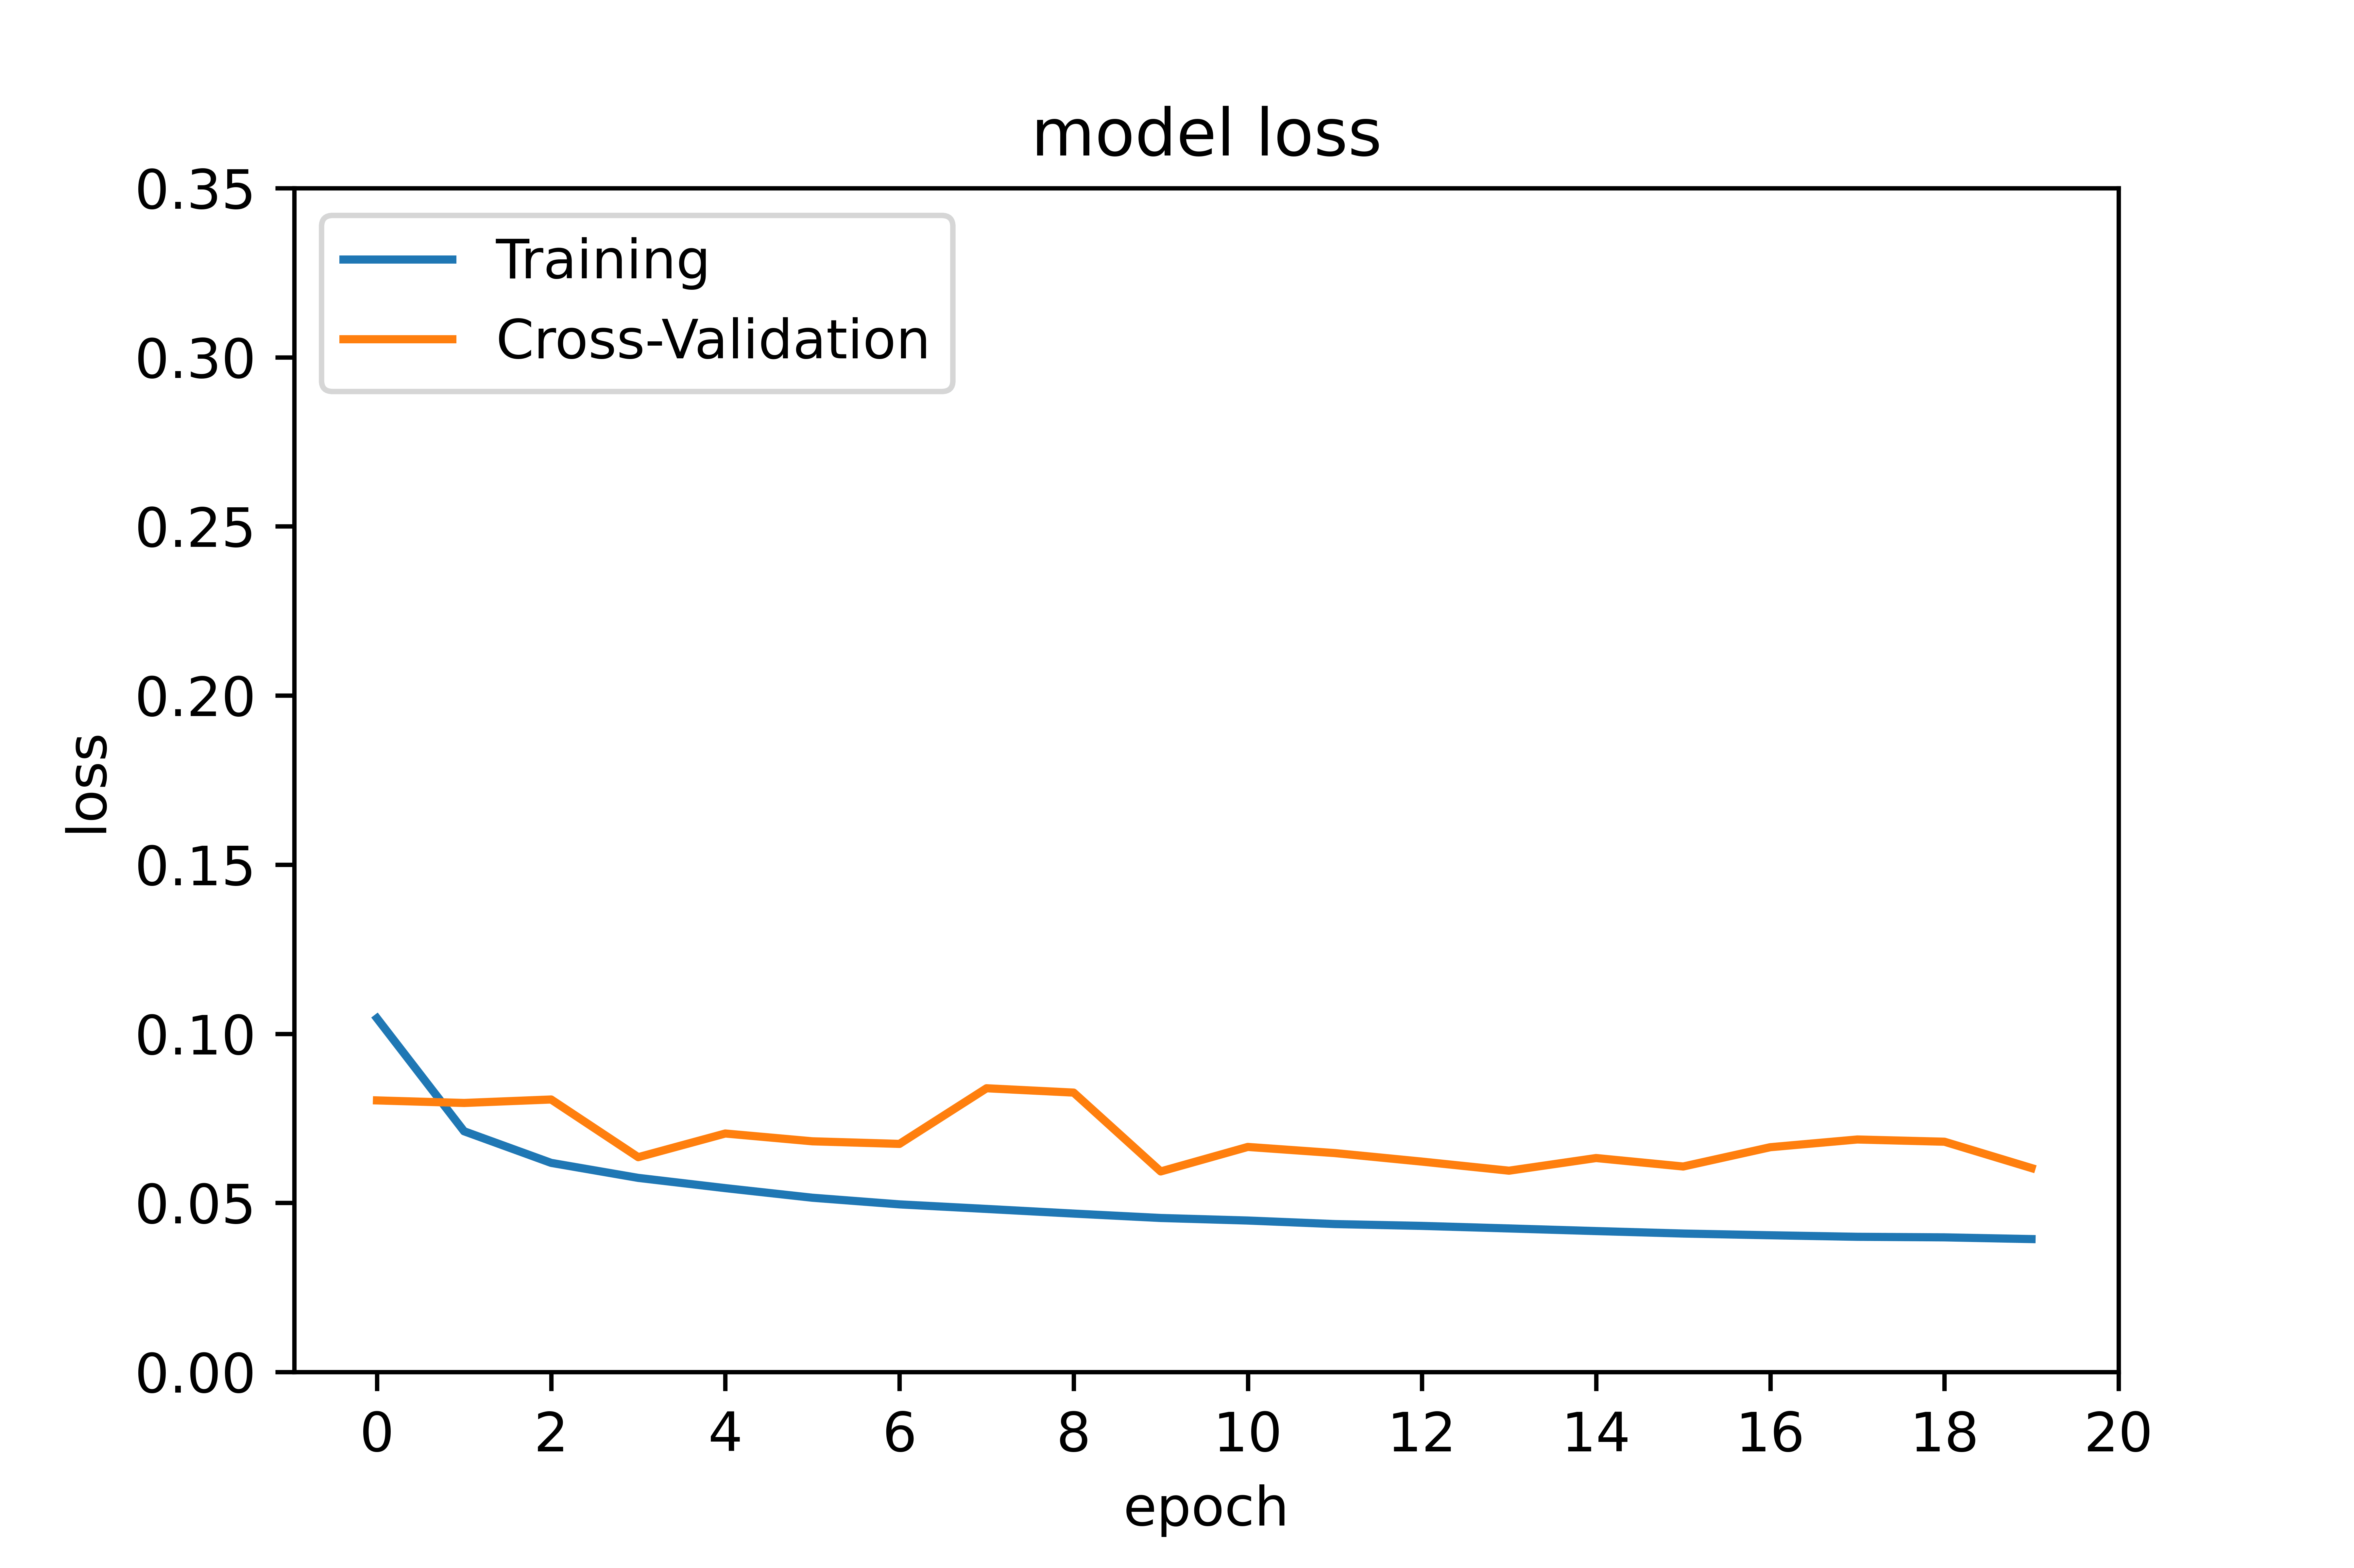
Model: Strategy and Inference
D. Choosing the loss function (MAE vs. MSE)
Inference:
MSE
Inflates or magnifies large errors(mean error)
“Punishes” model for larger errors
MAE
More reliable as validation loss mimics training loss as it should
Dataset 7p using MSE
Dataset 7p using MAE
Loss function = MAE
Dataset 9p using MSE
Dataset 9p using MAE

Slide 25
Optimization of Neural Network
In the context of NN, optimization refers to “non-convex optimization”, that which has multiple optima.
Aim of Optimization/hyperparameter tuning: Finding the global minimum on the loss surface
Challenges in optimizing a NN:
Learning rate: if it is too small, it takes too long to converge and if too large, it may never converge
Epochs: too many may have caused the model to over-fit and too less may cause under-fit.
Batch size: large batch size may result in slower convergence.

Slide 26
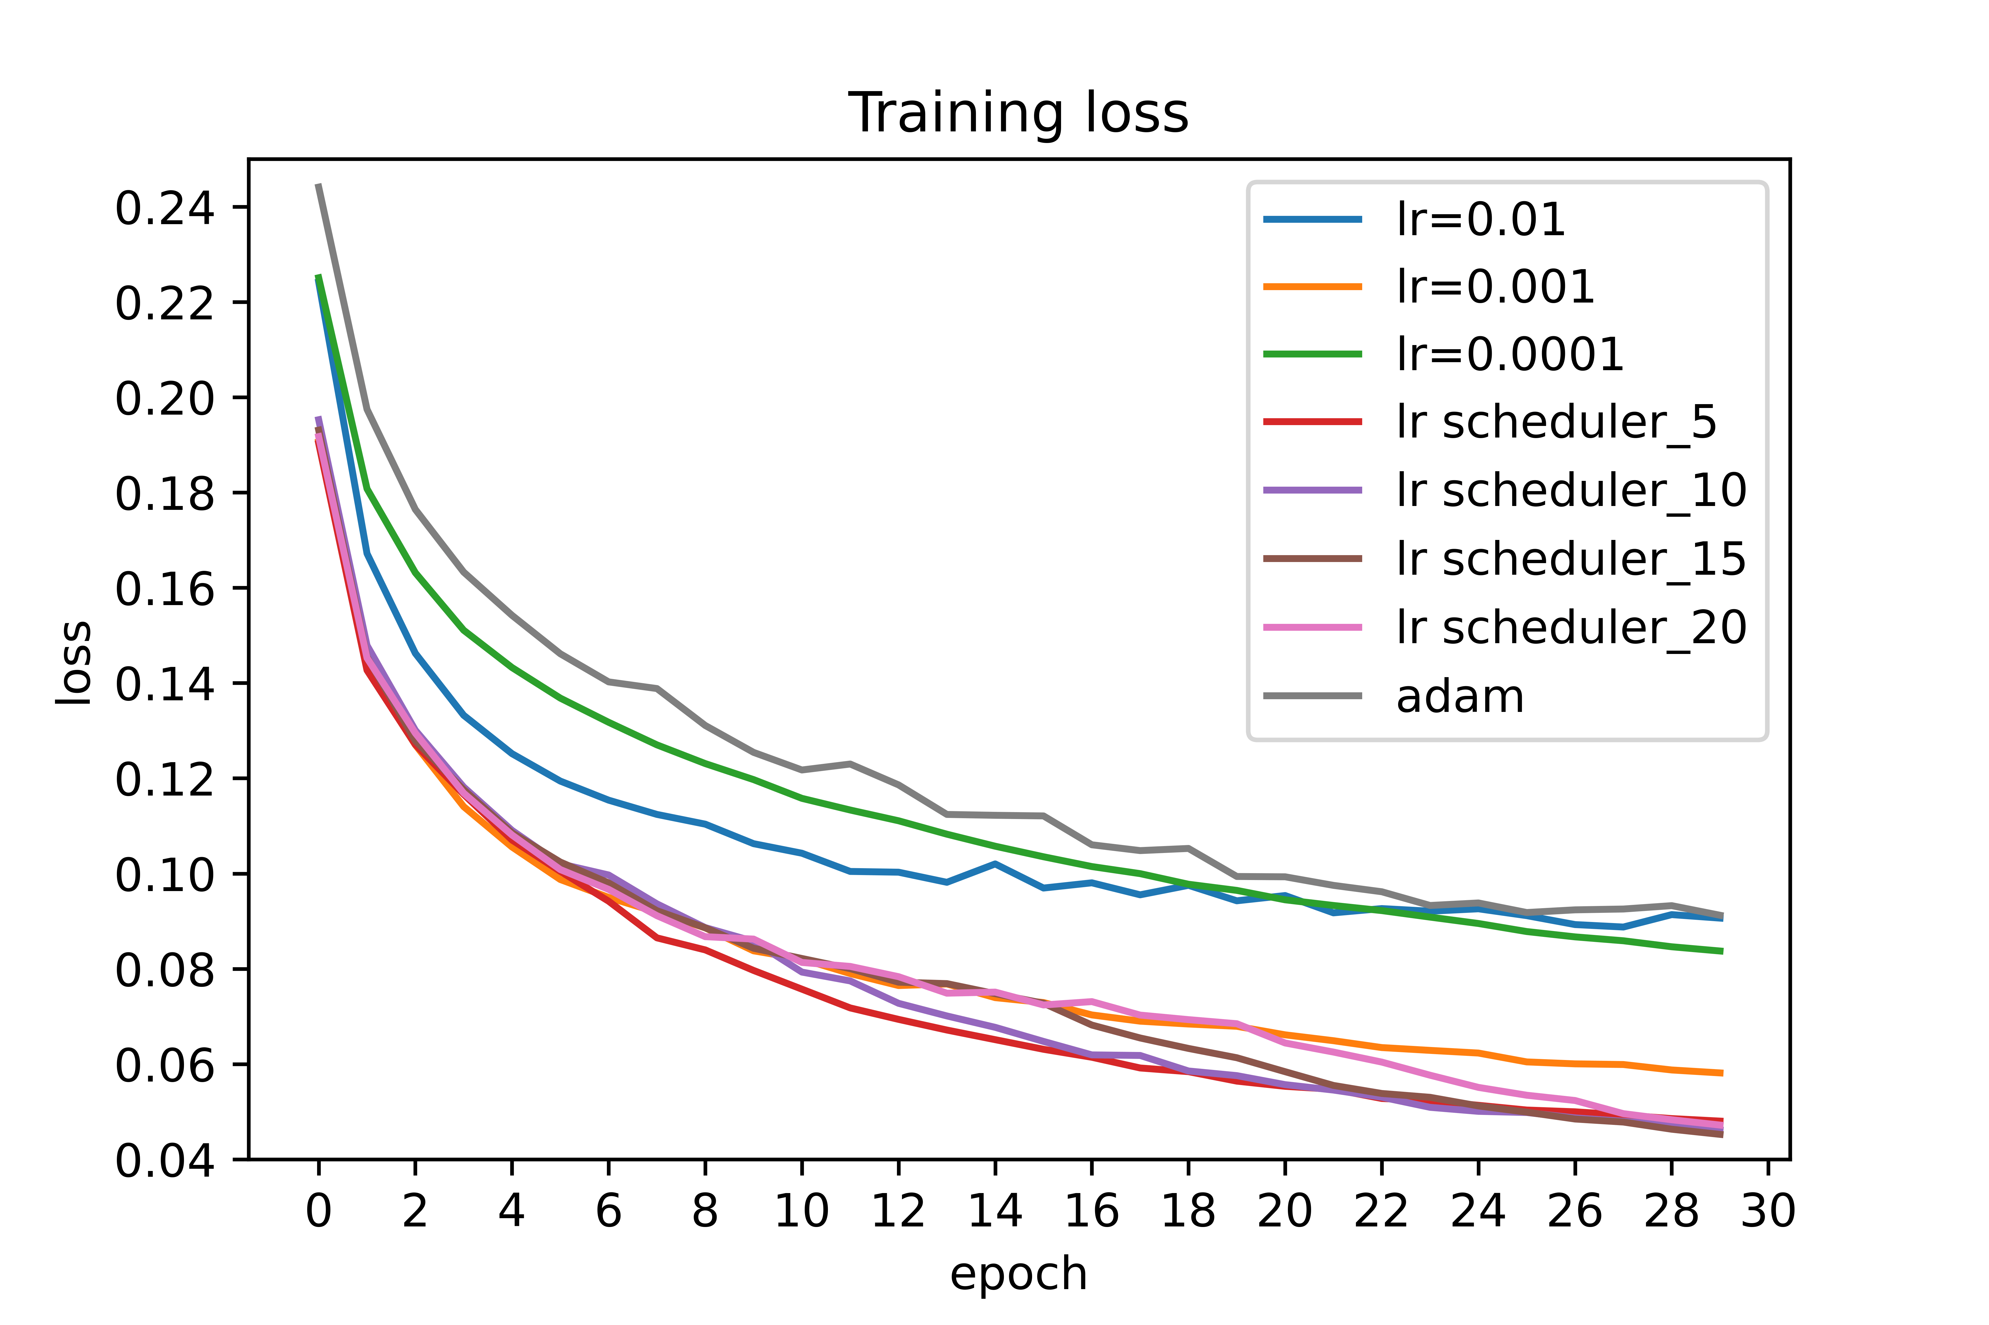
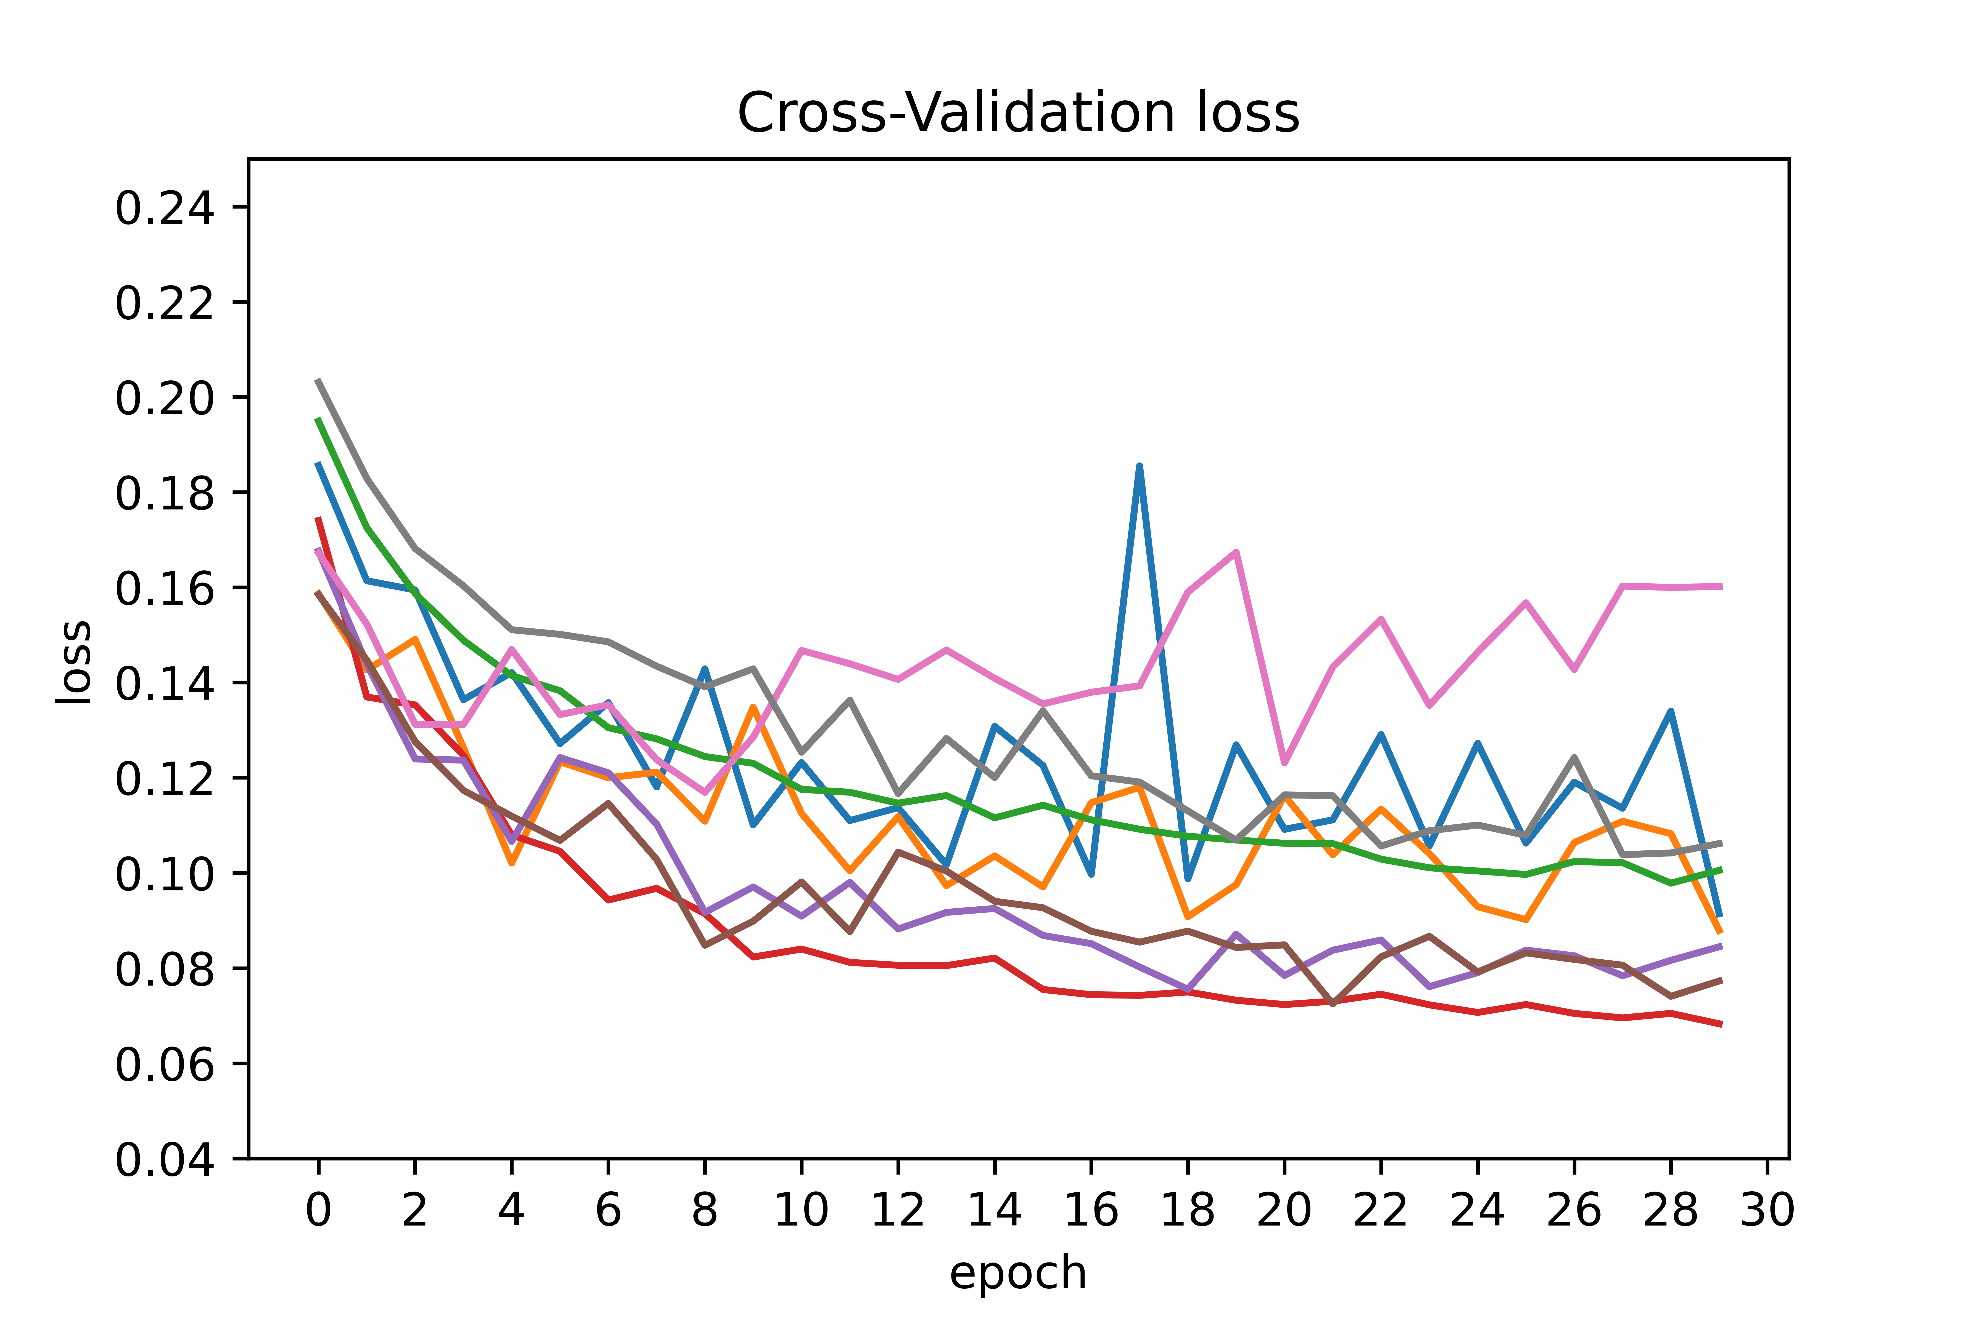
Model: Optimization and Inference
a. Tuning learning rate
Learning rate is decreased gradually over fixed epochs to compare the performance
Learning rate scheduler: punctuated large drops at specific epochs is employed
lr= 0.1, 0.01, 0.001, 0.0001 and lr scheduler for 5, 10, 15 and 20 epochs and adam (default) are implemented.
Inference:
Adapting the learning rate for this stochastic gradient descent optimization procedure can increase performance and reduce training time.
lr scheduler_5 performs reliably and better than adam.
Learning rate = lr scheduler_5

Slide 27
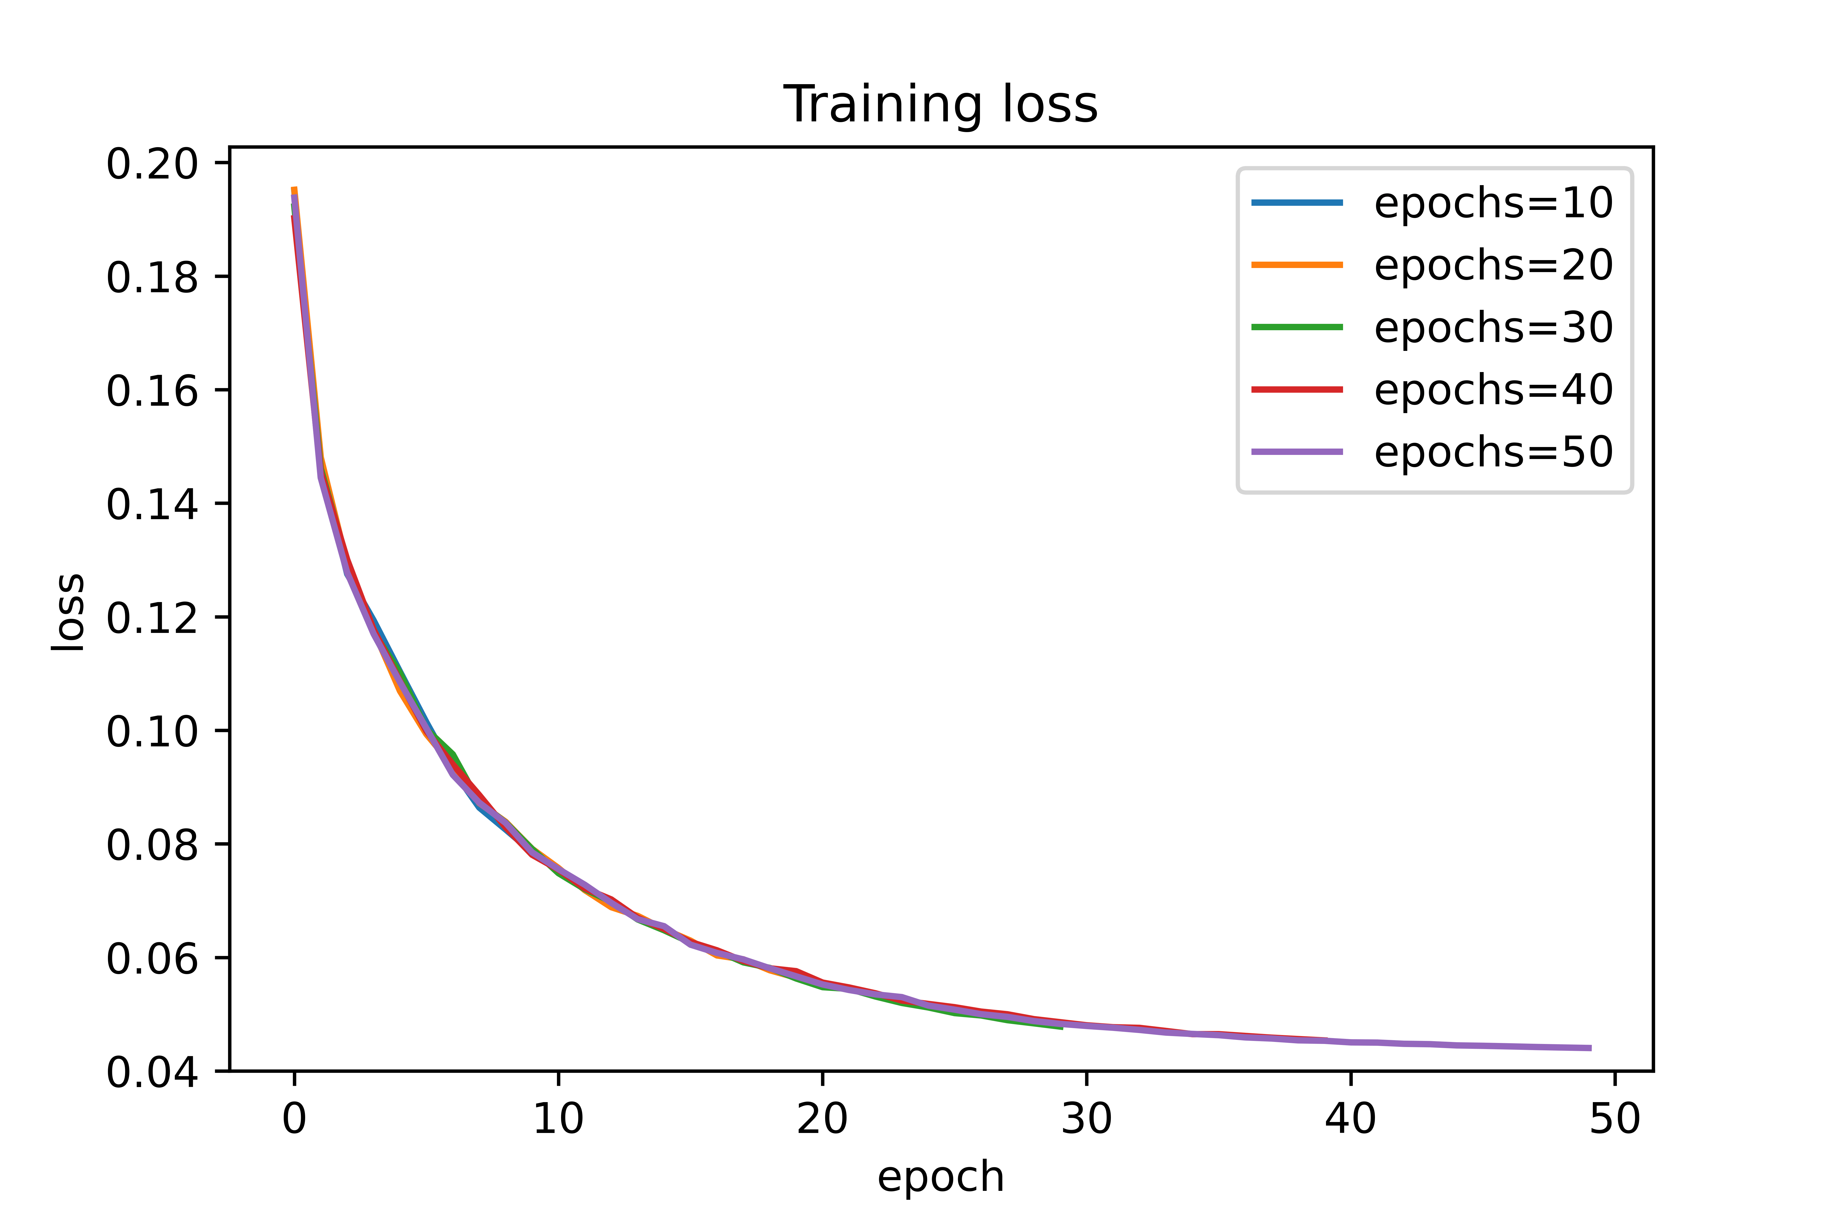
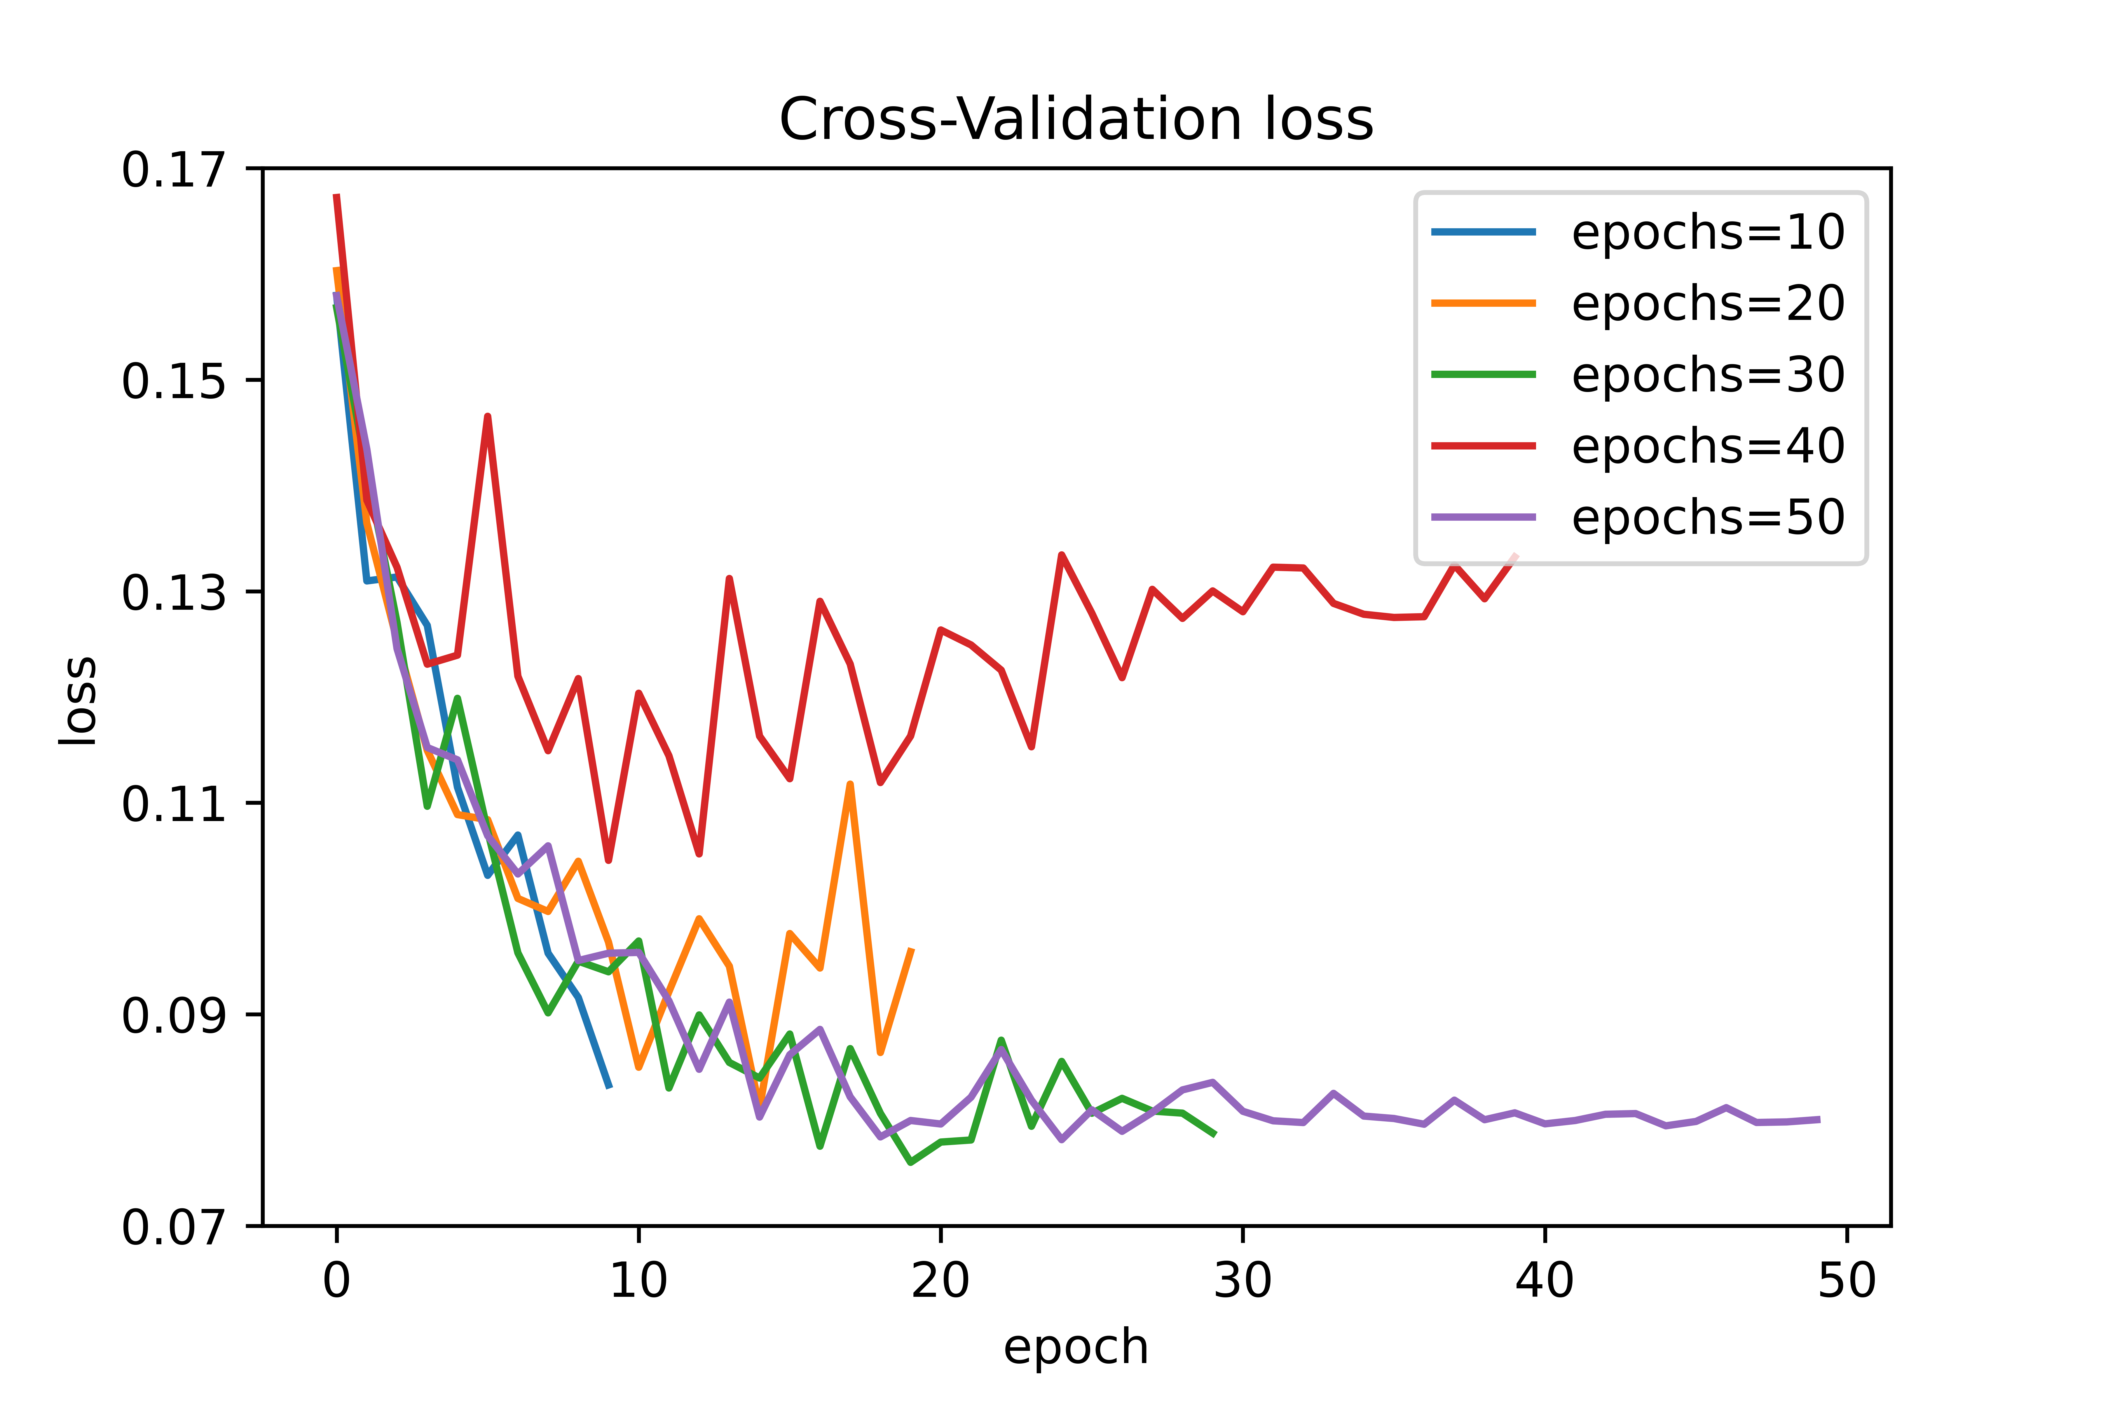
Model: Optimization and Inference
b. Tuning number of epochs
Model performance is observed for epochs 10, 20, 30, 40, 50
Inference:
In agreement with theory, with increase in epochs, the model fit improves but with few exceptions.
Model over-fit has been observed for epochs 20 and 40
At 30 and 50 epochs, the model performs reliably
Number of epochs = 30

Slide 28
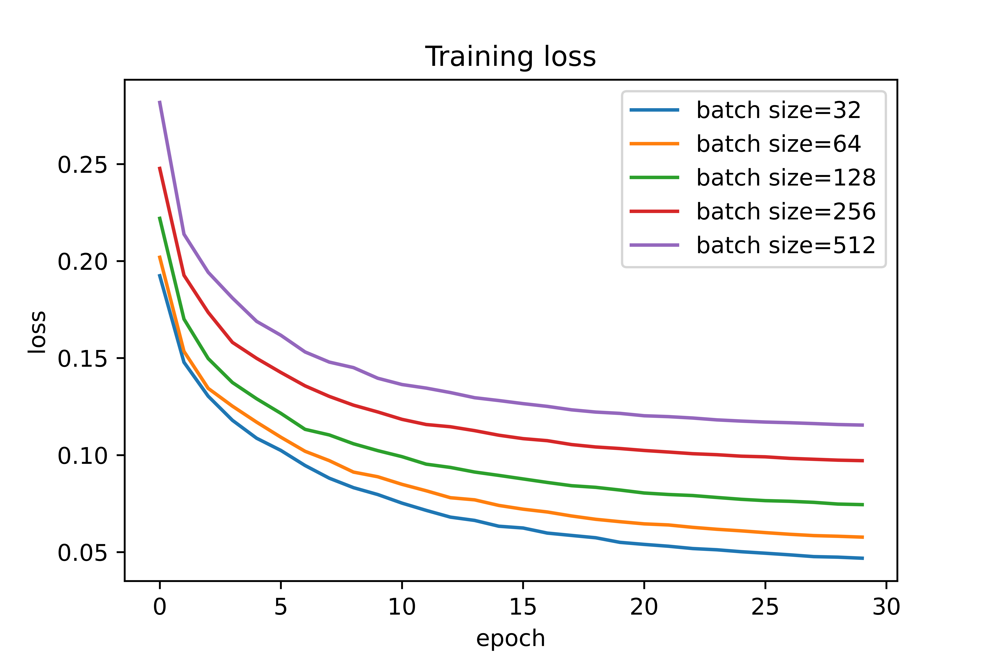
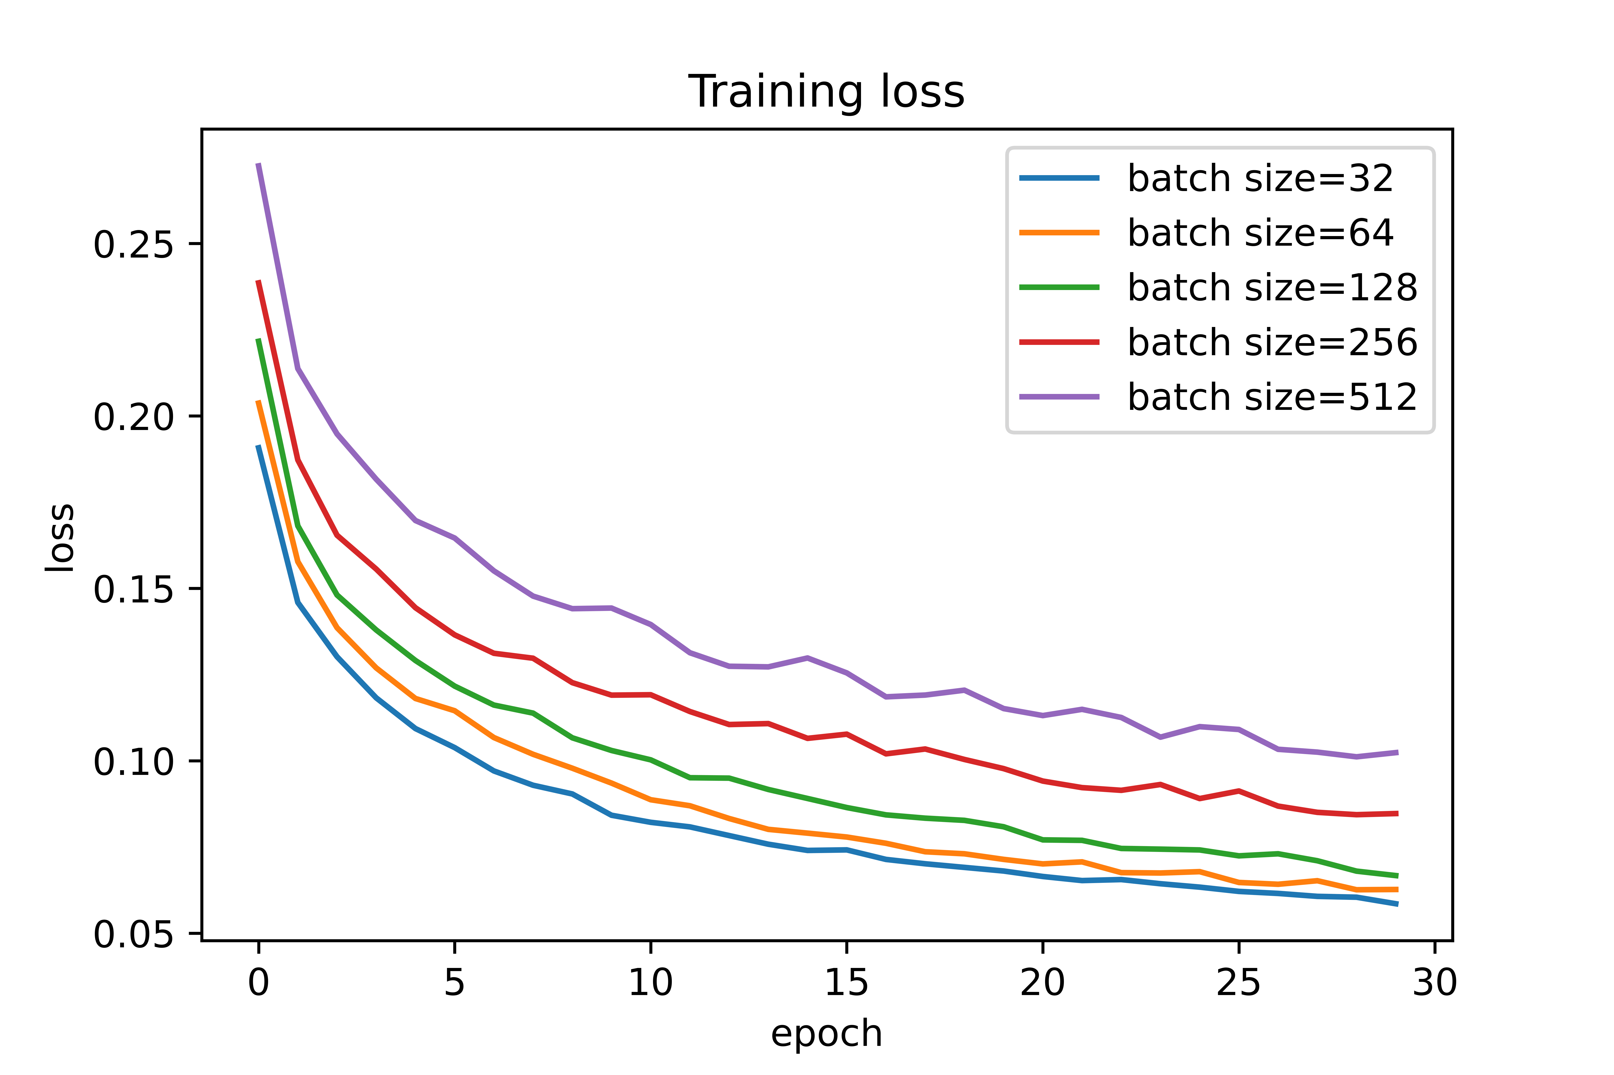
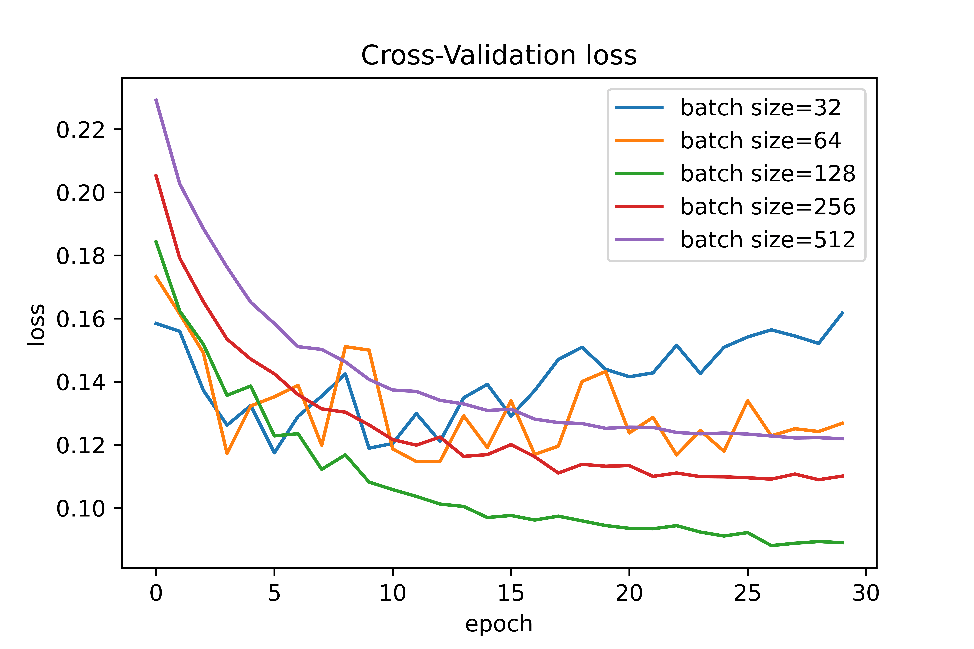
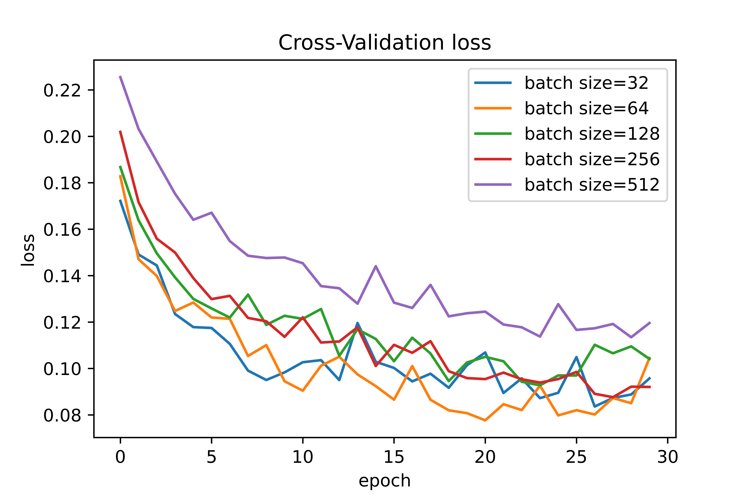
Model: Optimization and Inference
c. Tuning batch size
Model performance is investigated for different batch sizes, like, 32, 64, 128, 256 and 512 for different learning rates.
Inference:
Training loss decreases with decrease in batch size
Validation loss varies with batch size.
Batch size: 64 with adam and 128 with lr scheduler_5

Slide 29
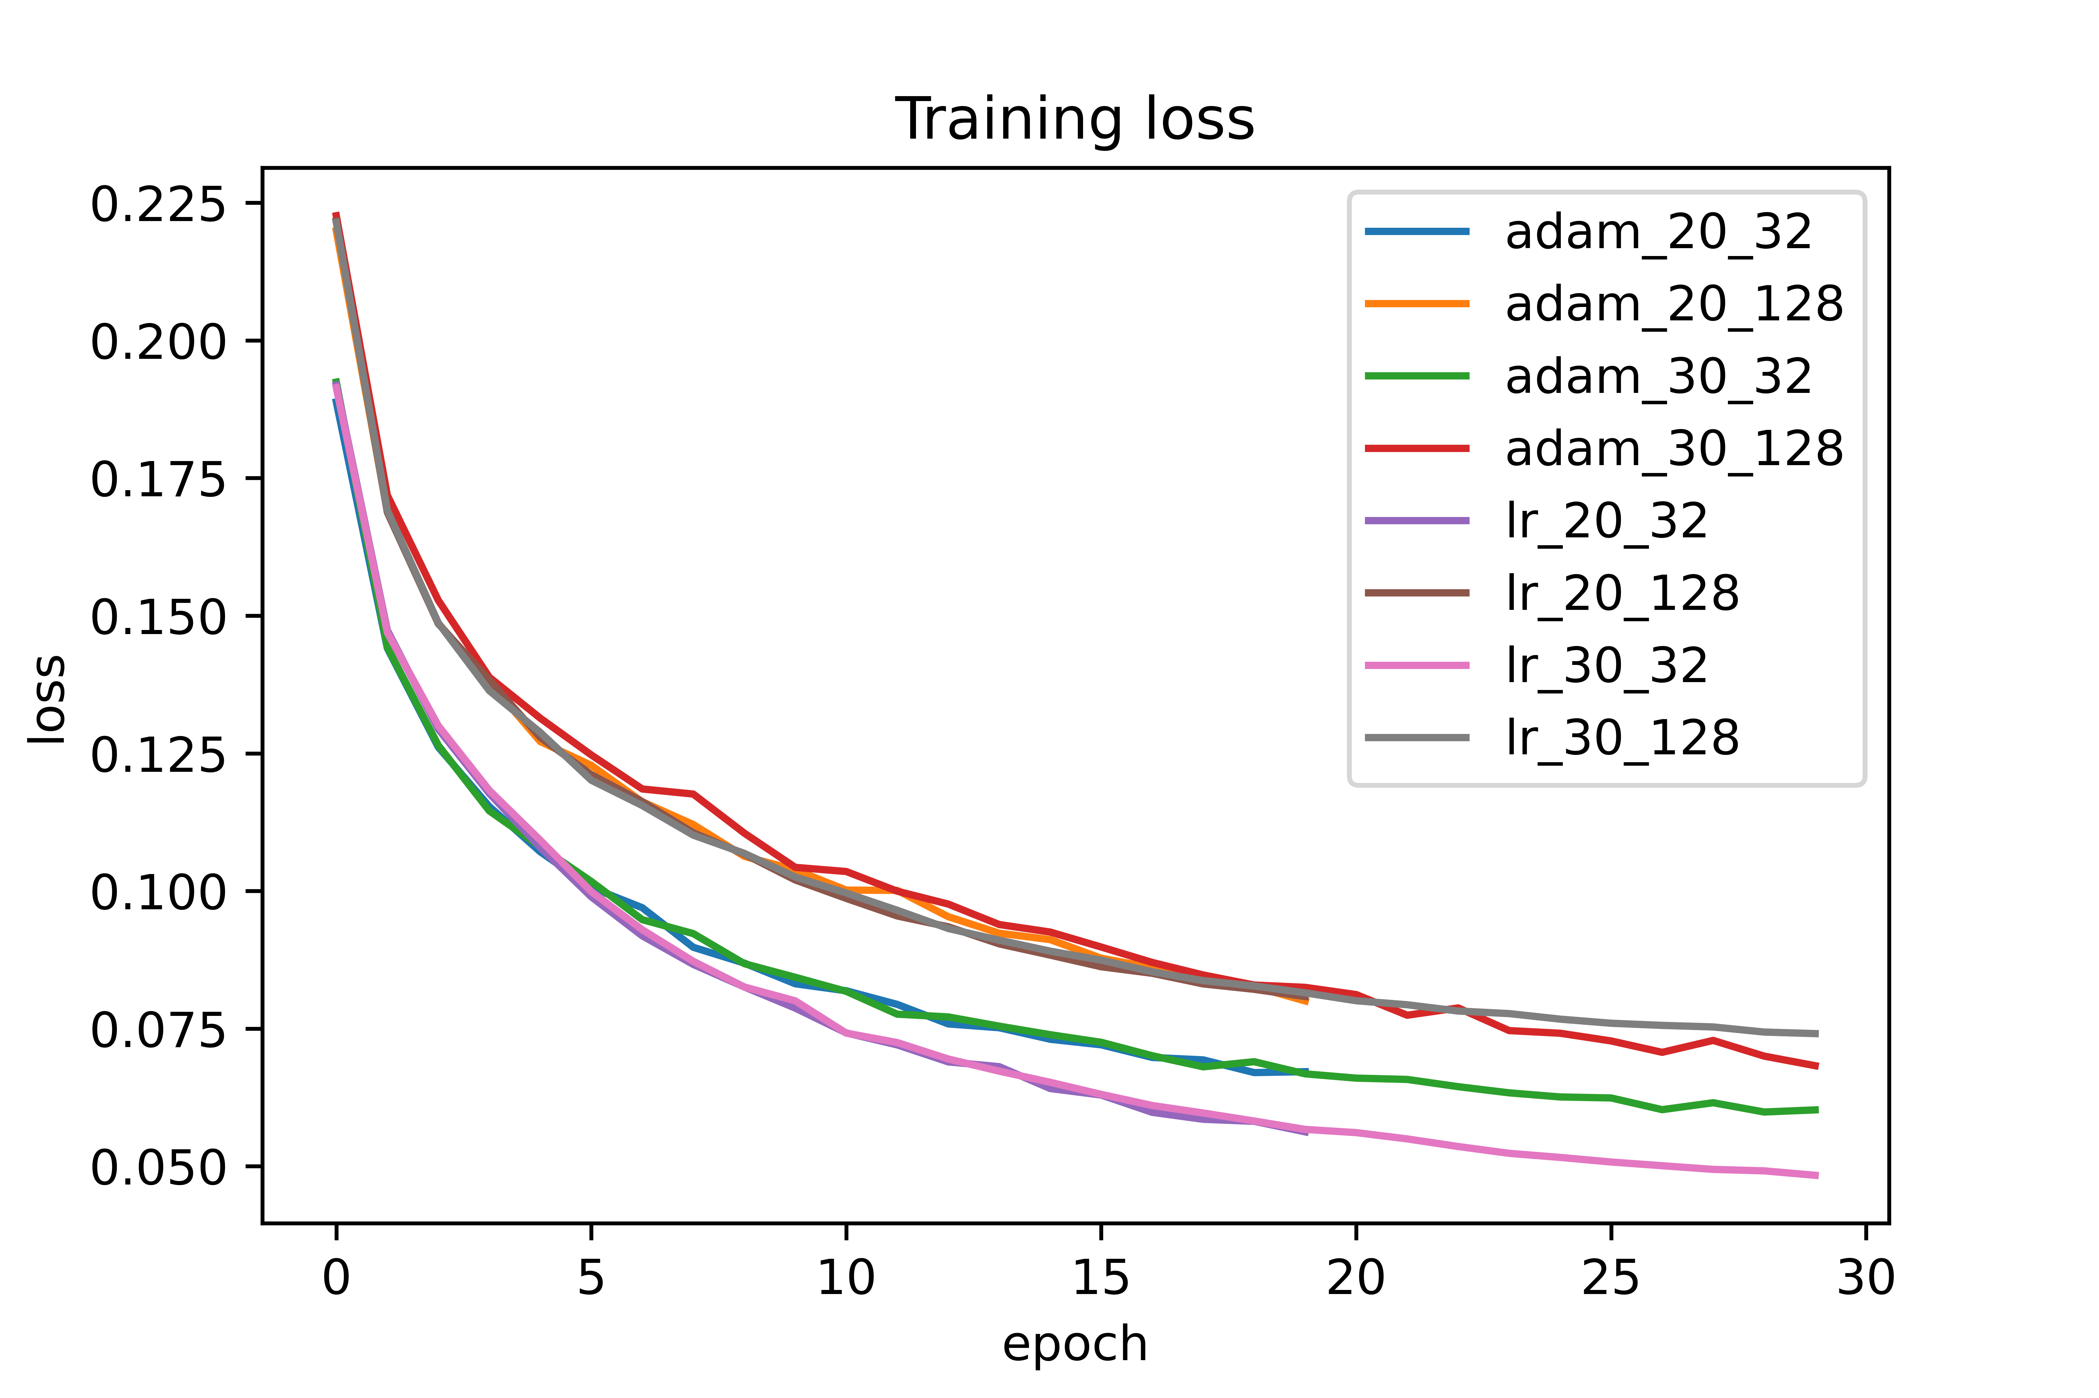
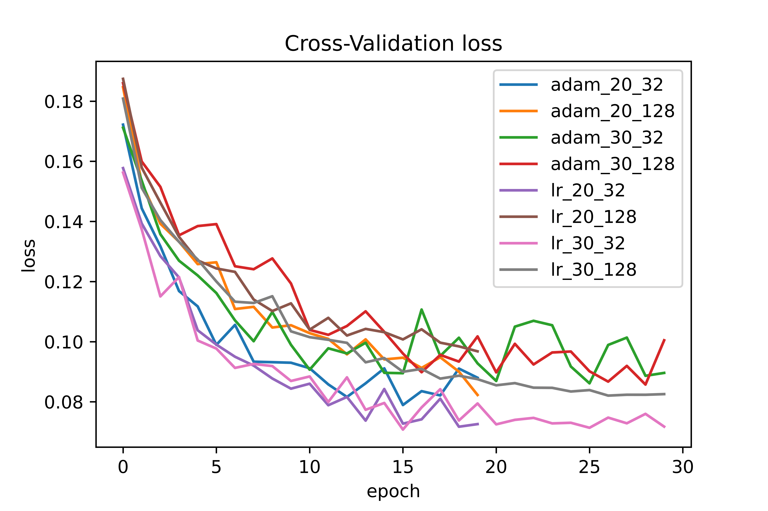
Comparison between optimized parameters
Set of optimized parameters are compared on dataset 5p:
adam_20_32
adam_20_128
adam_30_32
adam_30_128
lr_20_32
lr_20_128
lr_30_32
lr_30_128
Optimized set: lr_20_32 and lr_30_32

Slide 30
Evaluation of model
The model is evaluated using virtual experiments:
Adding noise to virtually measured strain data
Testing levels of loading outside training range
If sin(β) and cos (β) can serve as an error indicator

Slide 31
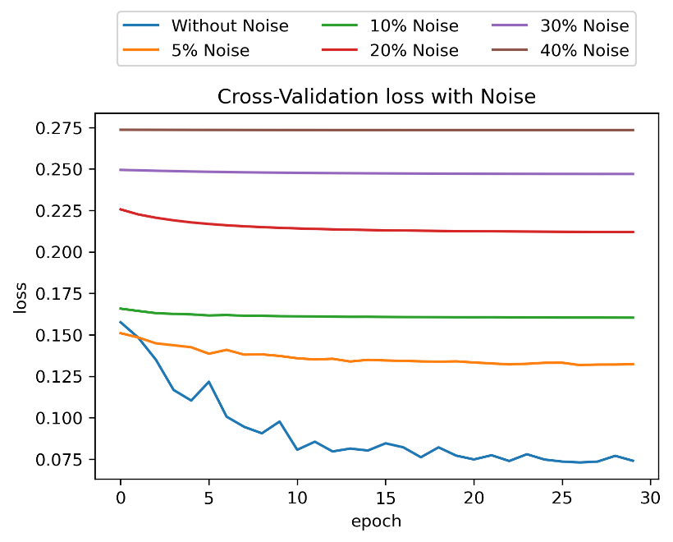
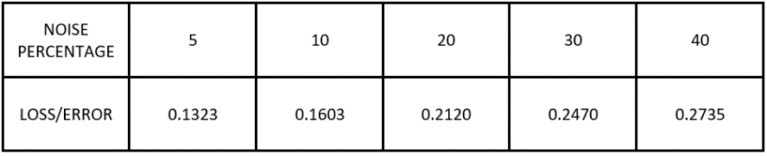
Experiment A (add noise)
Model is tested until which level of noise the predicted output remains reliable
Noise is added as small values in terms of percentage of range (maximum - minimum) value in strain data.
A uniform distribution is used to sample the noise levels.
Model performance is evaluated for different values of noise: 5%, 10%, 20%, 30% and 40% of range.
Inference:
Until 30% noise less can be sustained considering reliable performance is when model loss is below 0.25.

Slide 32
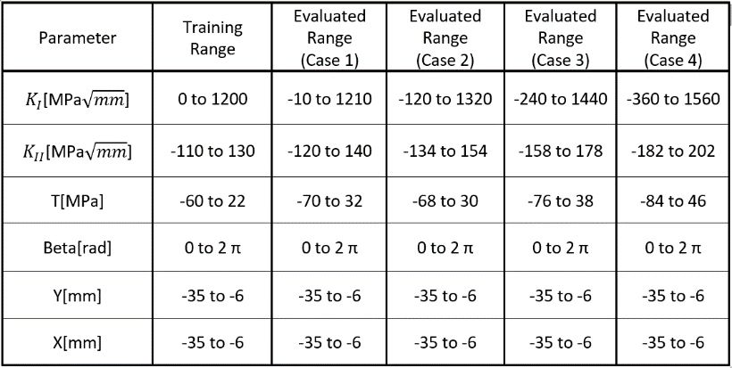
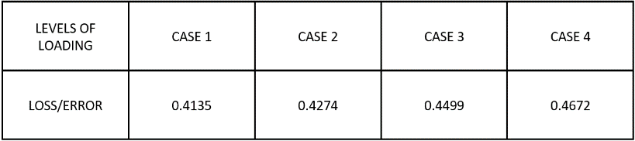
Experiment B (loading outside training range)
The minimum and maximum values of KI, KII and T are perturbed in terms of percentage of range (maximum - minimum) value in stress data.
The test data is generated for cases 1 to 4 with 1, 10, 20 and 30 % of range resp.
Inference:
Test loss for all cases is very high
If the loading range KI, KII and T are outside training range, the model fails to perform as expected.
Supports the ideology of NN
Testing data should lie within the training range

Slide 33

Experiment C (sin(β) and cos (β) as error indicator)
If the error in prediction of sin(β) and cos (β) correlates with model loss
Using Pythagorean trigonometric: $\sin^{2}$β + $\cos^{2}$β = 1
err_sincos = ${(sin}^{2}$β + $\cos^{2}$β) – 1
Err_sincos_mean = mean of predicted sin(β) and cos (β) for each epoch
Inference:
Validation loss of the model = Cβ * err_sincos_mean
Cβ is constant = -0.187924
Helps the user while evaluating the experimental value of strains from nano sensor
sin(β) and cos (β) can be used as error indicator

Slide 34
Comparison of different sensor layouts
Different layouts are:
Rectangular (4x4) layout
Rectangular (8x4) layout
Hexagonal layout
The comparison plots are plotted for parameters in the below sequence for each layout:
Training size (4p, 5p, 6p, 7p, 8p, 9p)
Learning rate (0.01, 0.001…, lr scheduler_20)
Epochs (10, 20, 30, 40, 50)
Batch size (32, 64, 128, 256, 512)
This comparison over different hyperparameters is to produce an optimized model for each layout.
Finally, the model performance of each layout is compared.

Slide 35

Optimized parameters for different layouts

Slide 36


Performance Comparison for all layouts
Aim is to identify which layout performs better.
Additionally, two other regular rectangular layouts 3x3 and 5x5 are also implemented and compared.
(4x4) layout has lowest cross validation loss
(8x4) layout performs slightly better than (3x3) and (5x5) layouts keeping validation loss close to training loss
Hexagonal layout, even with less number of sensors, performs exceptionally, competing with (4x4) layout.

Slide 37
Inference from comparison plots
Hexagonal layout ≥ (4x4) layout > (8x4) layout > (3x3) layout > (5x5) layout
Placement of sensors in close quarters to each other is an advantage for hexagonal layout.
This keeps the readings in close range and better predictions even with realistic data where noise is inevitable.
However, (4x4) has a simple arrangement of sensors compared to complex distribution in Hexagonal layout.

Slide 38
Conclusion
Neural Networks is implemented to solve the inverse problem from the sensor concept applied at the crack tip on specimen surface.
Neural Networks are applied to generate a model that predicts KI , KII , T − stress, cos β,sin β, Y0, X0 from strain field obtained from nano sensors.
The models are generated for different sensor layout and optimized using different hyperparameters.
The (4x4) rectangular model is tested using virtual experiments to check the performance:
It performs reliably until 30% of noise in strain data.
It fails when the testing data is outside the training range.
The error in predictions of sin(β) and cos (β) could be used to identify model loss with the help of Pythagorean trigonometric.

Slide 39
Conclusion
The model performance of layouts is compared with each other.
Hexagonal and Regular rectangular (4x4) layouts give better performance compared to others.
The sensor concept was initially implemented in [1], [2] and [3], with an aim to identify crack location. The limitations mentioned were :
Electrodes have to be placed within a radius
Prediction depends on the choice of suitable initial value for solving nonlinear equation system.
Good results were obtained only for pure Mode-I loading and not for pure Mode-II loading.

Slide 40
Conclusion
These limitations are overcome by the Neural Networks approach.
All types of loading conditions could be trained.
Sensors could be placed in any different distances from each other
NN takes care of initial value guessing
Only limitation is that the model performs as expected only within the training range of the data.
But, NN implementation is efficient at every step and provides many facilities to adapt the model to a suitable problem.
There is always a facility to train a model with desired output
It provides minimum loss and a scope for much desired scientific experimentation.

Slide 41
References
M Kuna and D Bäcker. A pvdf sensor for the in-situ measurement of stress intensity factors during fatigue crack growth. Procedia materials science, 3:473–478, 2014.
Dennis Bäcker, Andreas Ricoeur, and Meinhard Kuna. Sensor concept based on piezo-electric pvdf films for the structural health monitoring of fatigue crack growth. 2011.
Nikhil Ketkar and Eder Santana. Deep learning with python, volume 1. Springer, 2017.
D Bäcker, C Häusler, and M Kuna. Piezoelectric sensor for in situ measurement of stress intensity factors. In Sensors and Smart Structures Technologies for Civil, Mechanical, and Aerospace Systems 2011, volume 7981, page 79812T. International Society for Optics and Photonics, 2011.
Ivan Nunes Da Silva, Danilo Hernane Spatti, Rogerio Andrade Flauzino, Luisa Helena Bartocci Liboni, and Silas Franco dos Reis Alves. Artificial neural network architectures and training processes. In Artificial neural networks, pages 21–28. Springer, 2017.
Serokell. Artificial intelligence vs. machine learning vs. deep learning: What’s the difference, 2021-06-20. URL https://ai.plainenglish.io/artificial-intelligence-vs-machine-learning-vs-deep-learning-whats.
Fujimoto, Y., Shintaku, E., Pirker, G., Tanaka, Y., "Stress Intensity Factor Measurement of Two-Dimensional Cracks by the Use of Piezoelectric Sensor", JSME, Series A, Vol. 46, No. 4, 567-574 (2003)
Fujimoto, Y., Liu, G., Tanaka, Y., Im, E., "Stress Intensity Factor Measurement of Cracks Using a Piezoelectric Element", Experimental Mechanics, Vol. 44, No. 3, 320-325 (June/2004)

